Slide 1
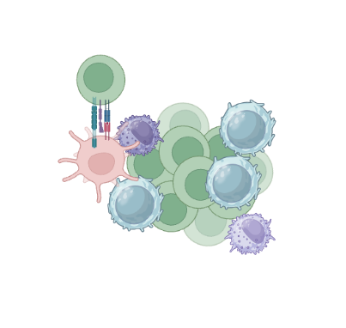
CRIS D and immune system: a controversial relationship

Slide 2
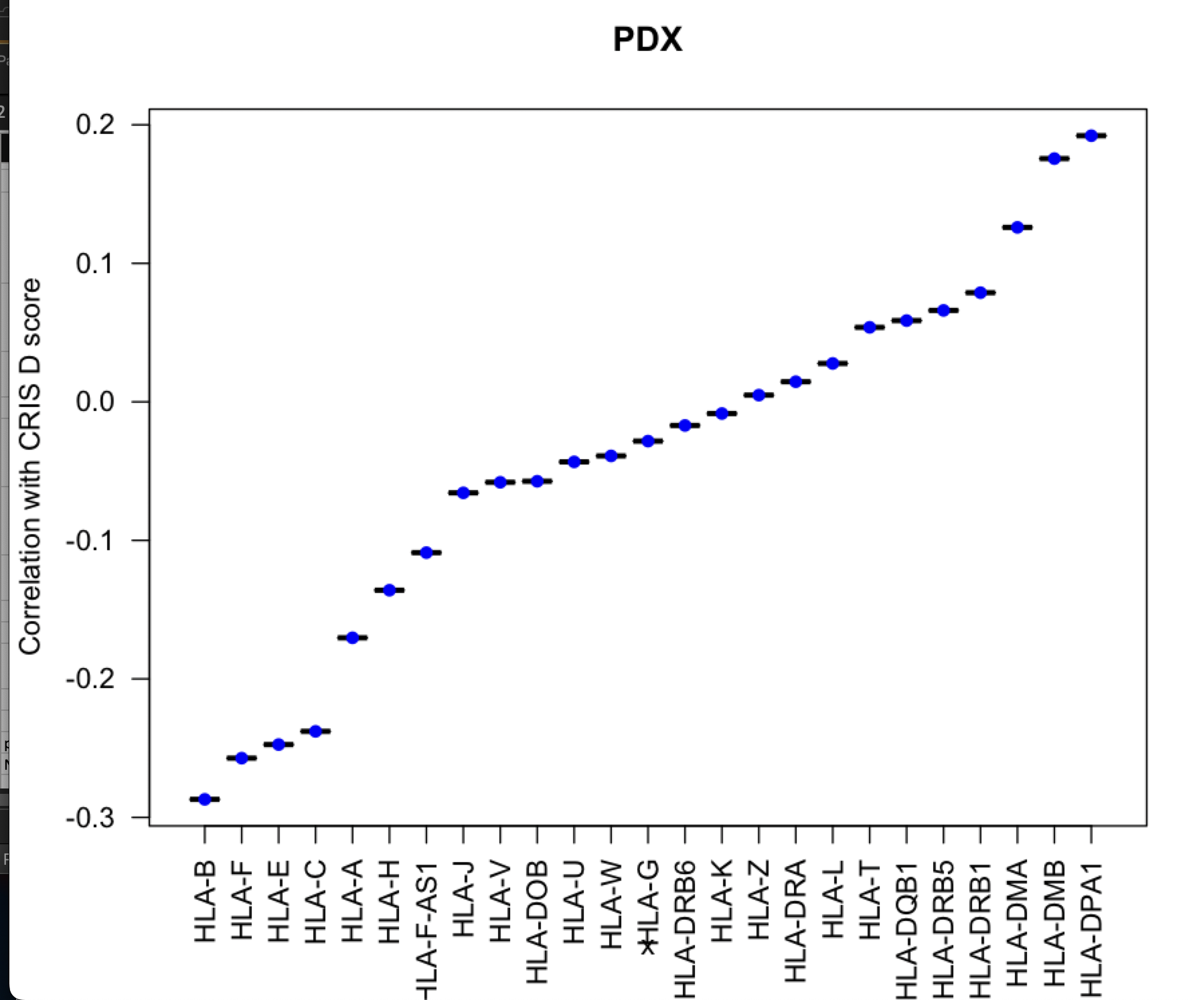
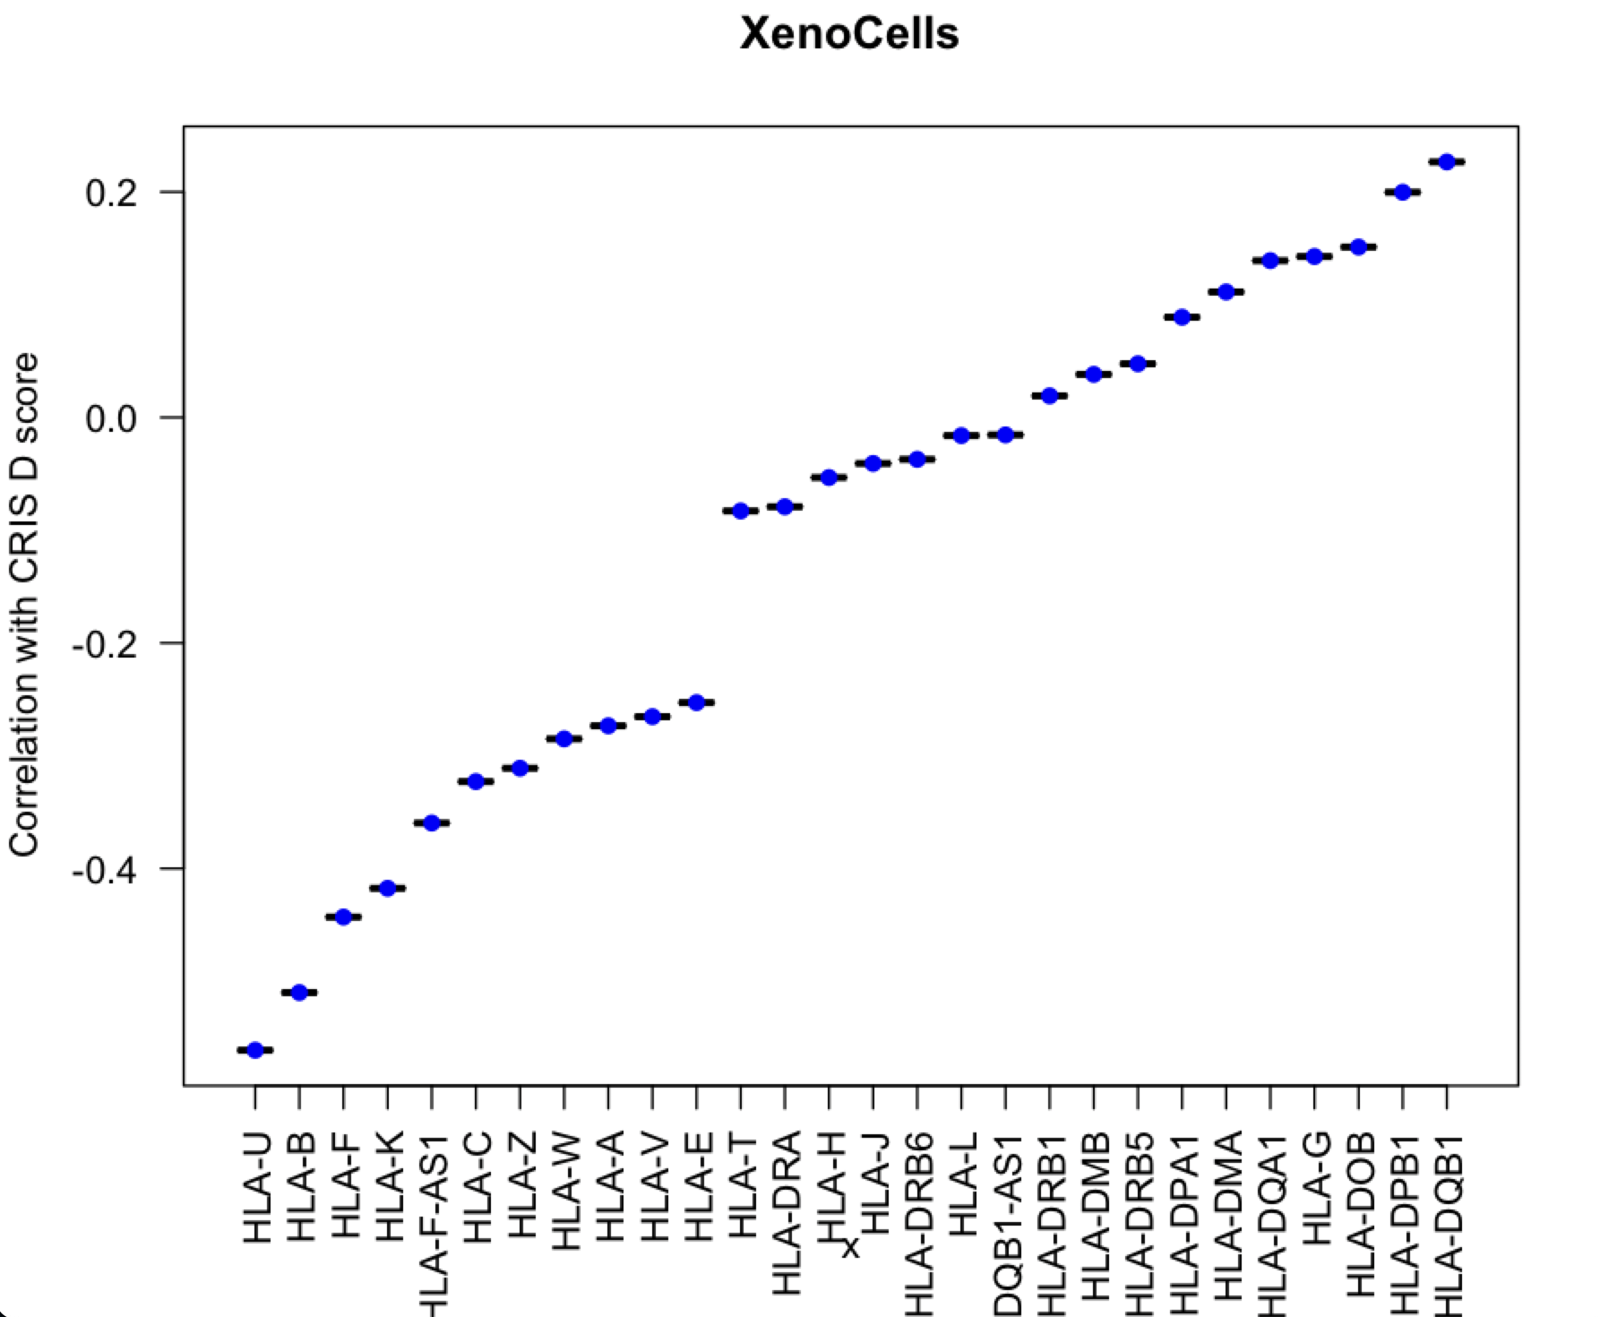
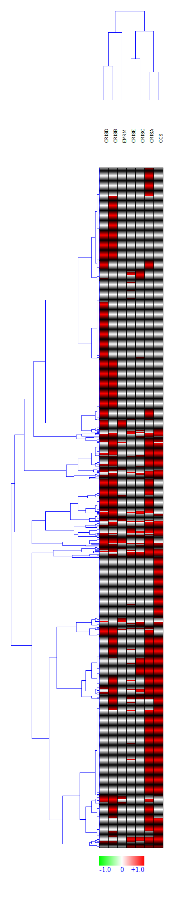
Our previous findings

Slide 3
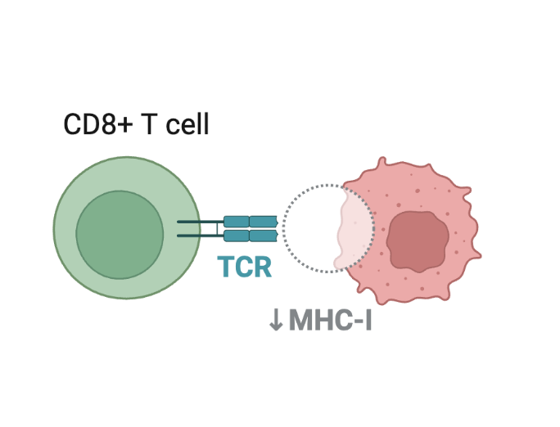
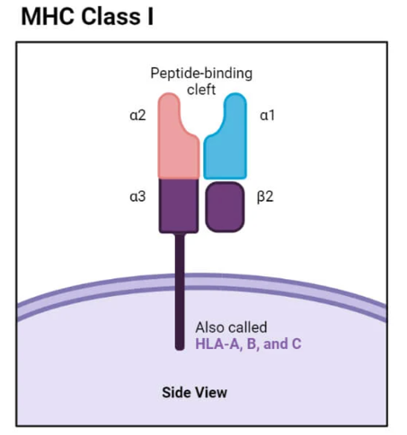
HLA-A | major histocompatibility complex, class I, A
HLA-B | major histocompatibility complex, class I, B
HLA-C | major histocompatibility complex, class I, C
HLA-E | major histocompatibility complex, class I, E
HLA-F | major histocompatibility complex, class I, F
HLA-G | major histocompatibility complex, class I, G
HLA-H | major histocompatibility complex, class I, H (pseudogene)
HLA-J | major histocompatibility complex, class I, J (pseudogene)
HLA-K | major histocompatibility complex, class I, K (pseudogene)
HLA-L | major histocompatibility complex, class I, L (pseudogene)
HLA-N | major histocompatibility complex, class I, N (pseudogene)
HLA-P | major histocompatibility complex, class I, P (pseudogene)
HLA-S | major histocompatibility complex, class I, S (pseudogene)
HLA-T | major histocompatibility complex, class I, T (pseudogene)
HLA-U | major histocompatibility complex, class I, U (pseudogene)
HLA-V | major histocompatibility complex, class I, V (pseudogene)
HLA-W | major histocompatibility complex, class I, W (pseudogene)
HLA-X | major histocompatibility complex, class I, X (pseudogene)
HLA-Y | major histocompatibility complex, class I, Y (pseudogene)
HLA-Z | major histocompatibility complex, class I, Z (pseudogene)
MHC Class I genes: What is their role?

Slide 4
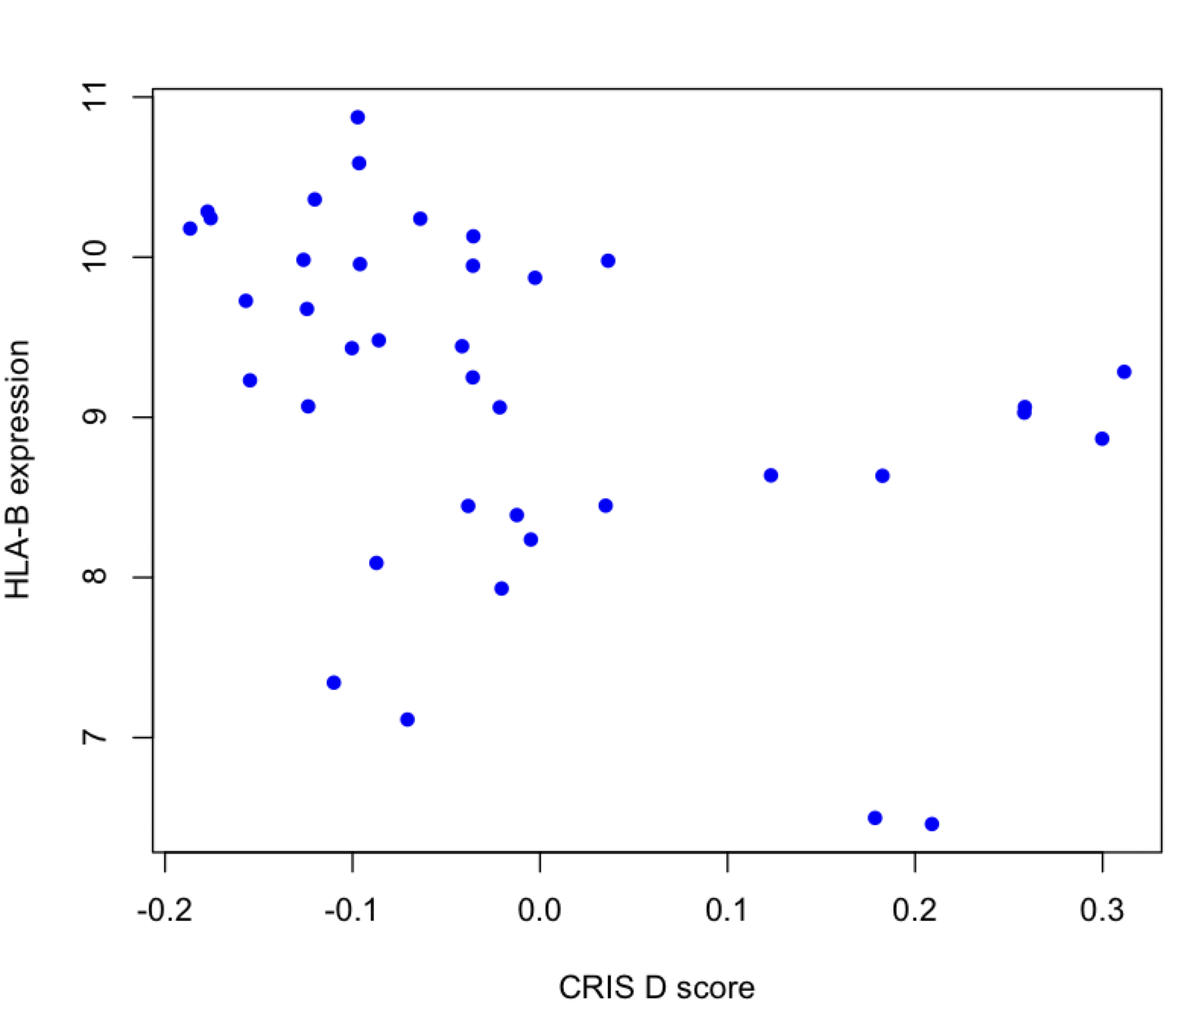
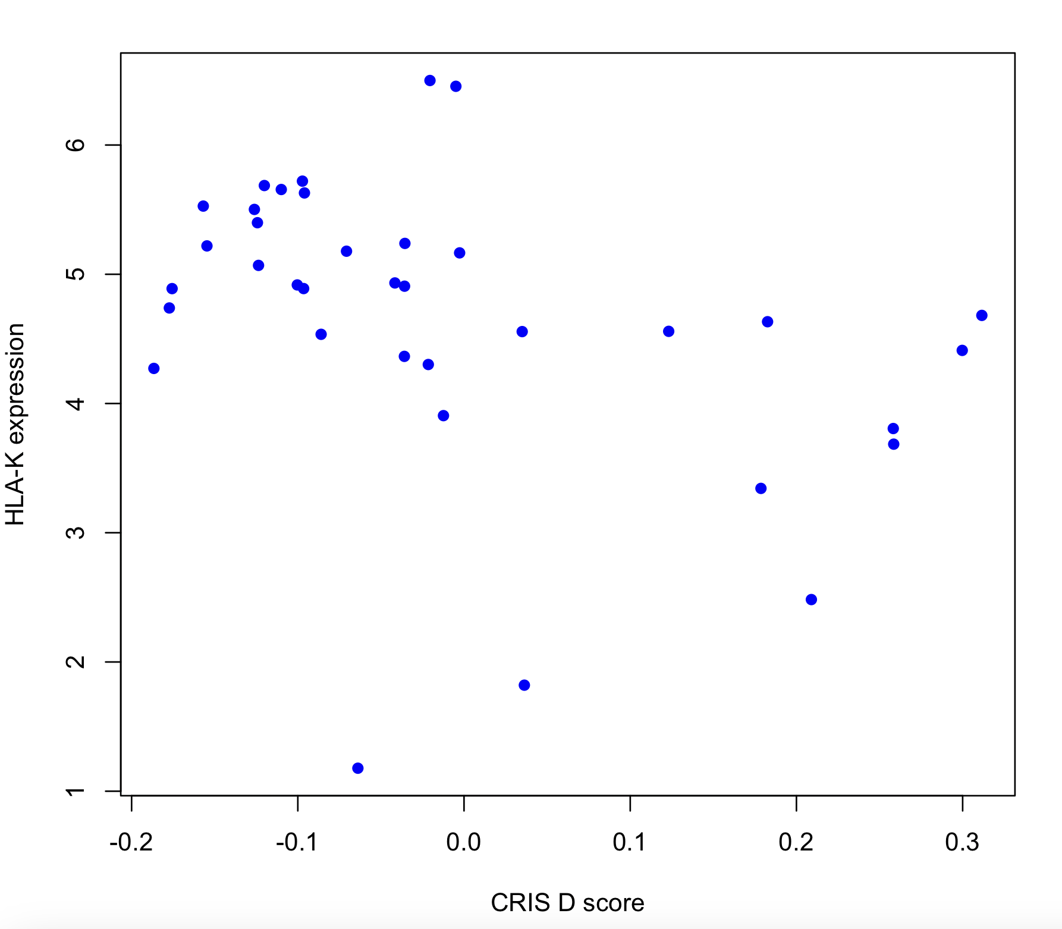
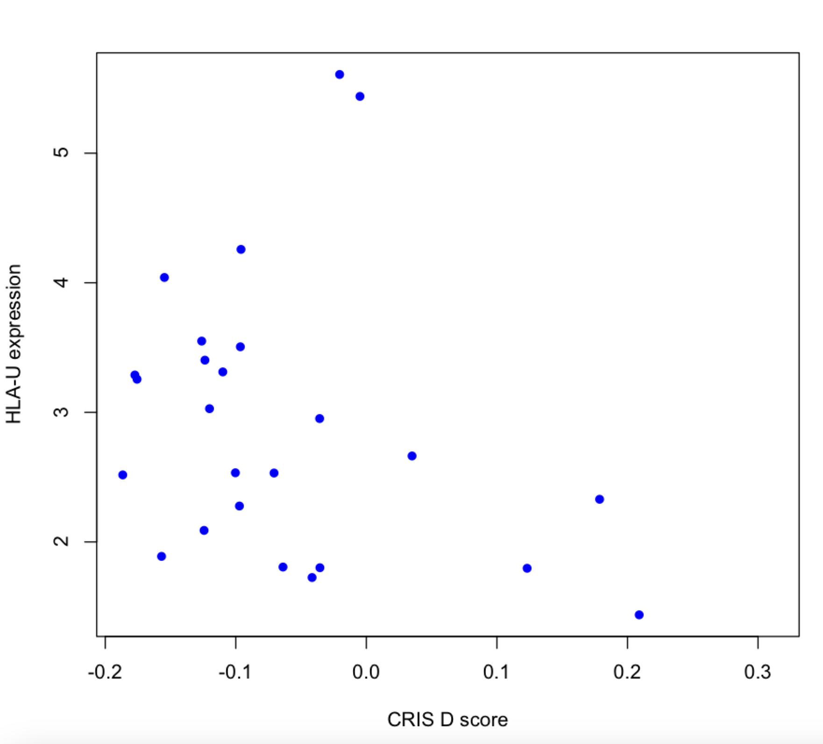
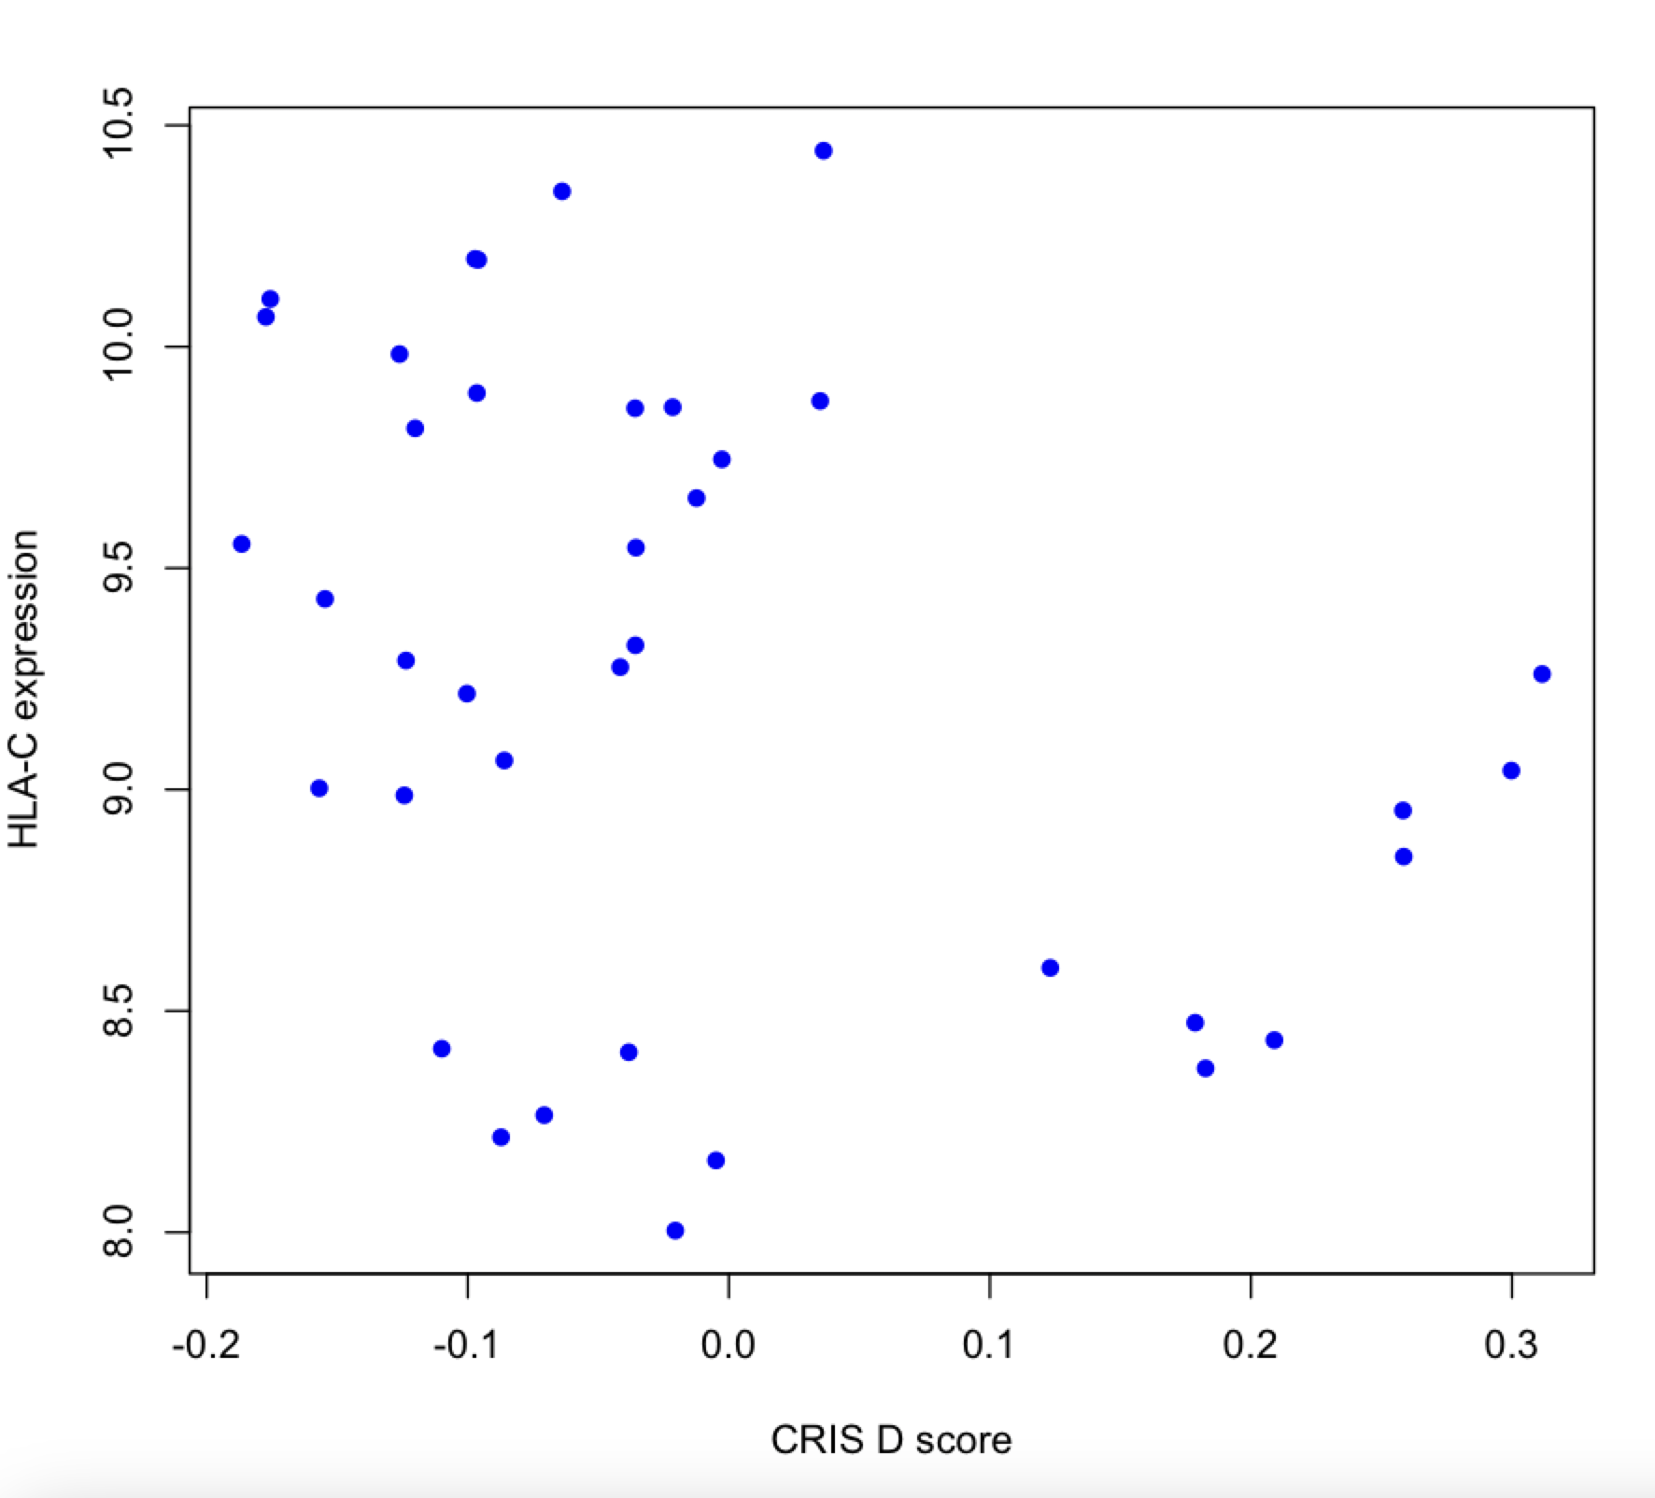
Our results in Xeno Cells

Slide 5
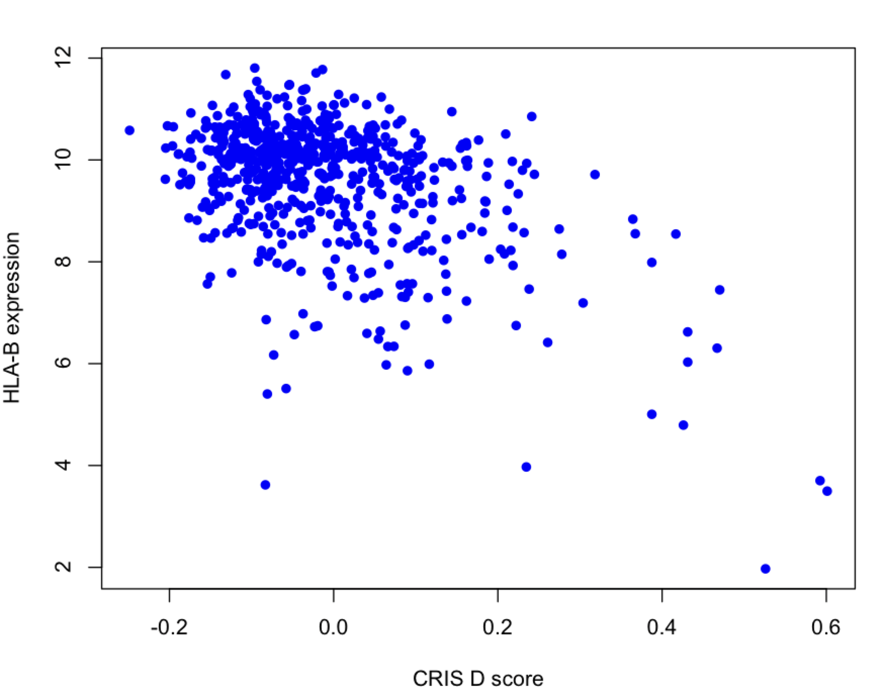
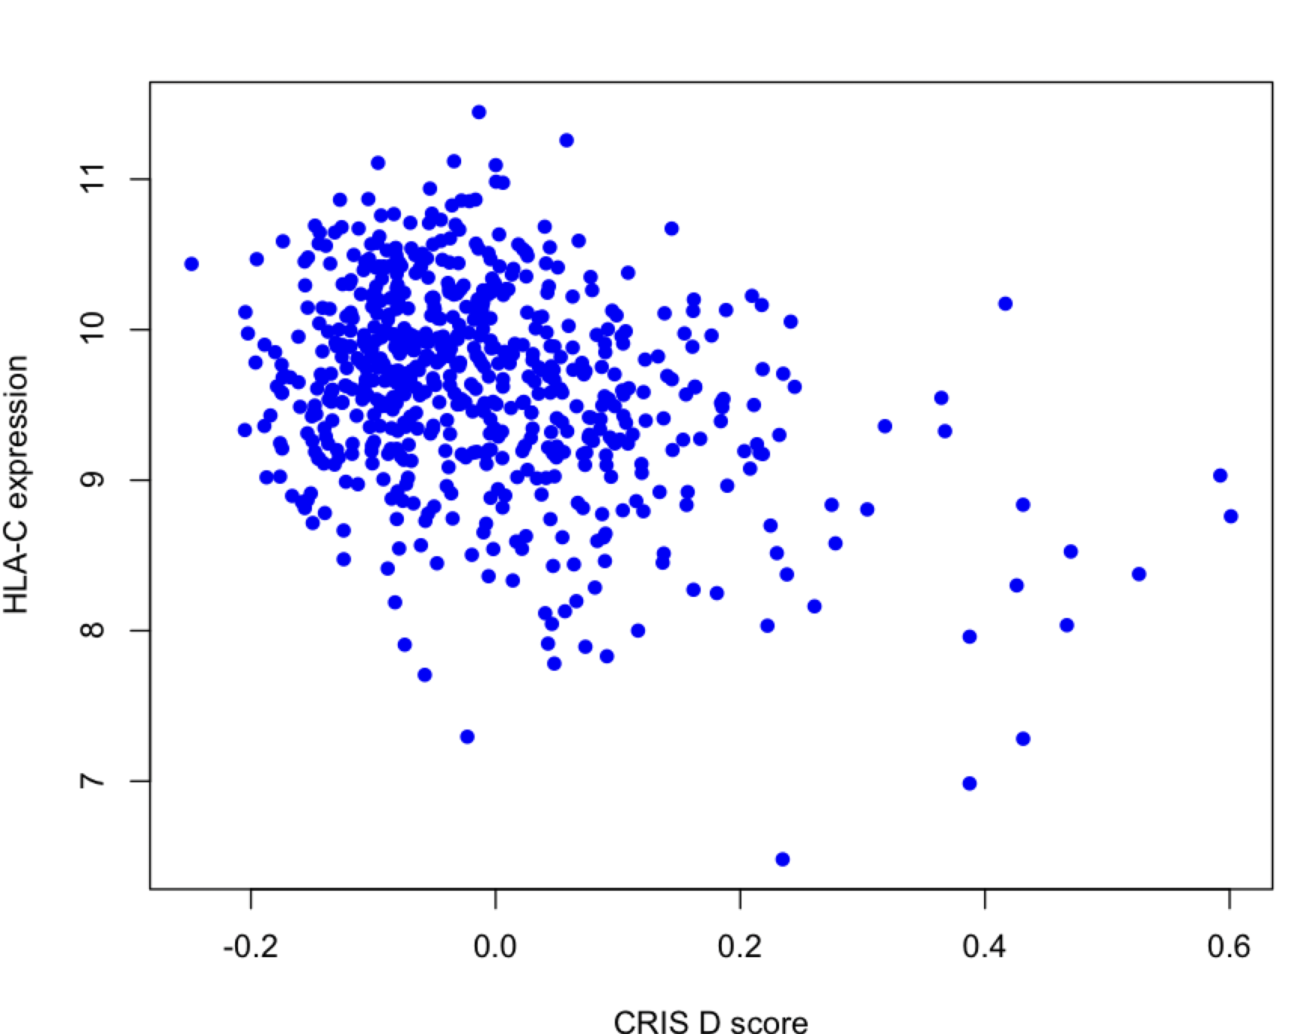
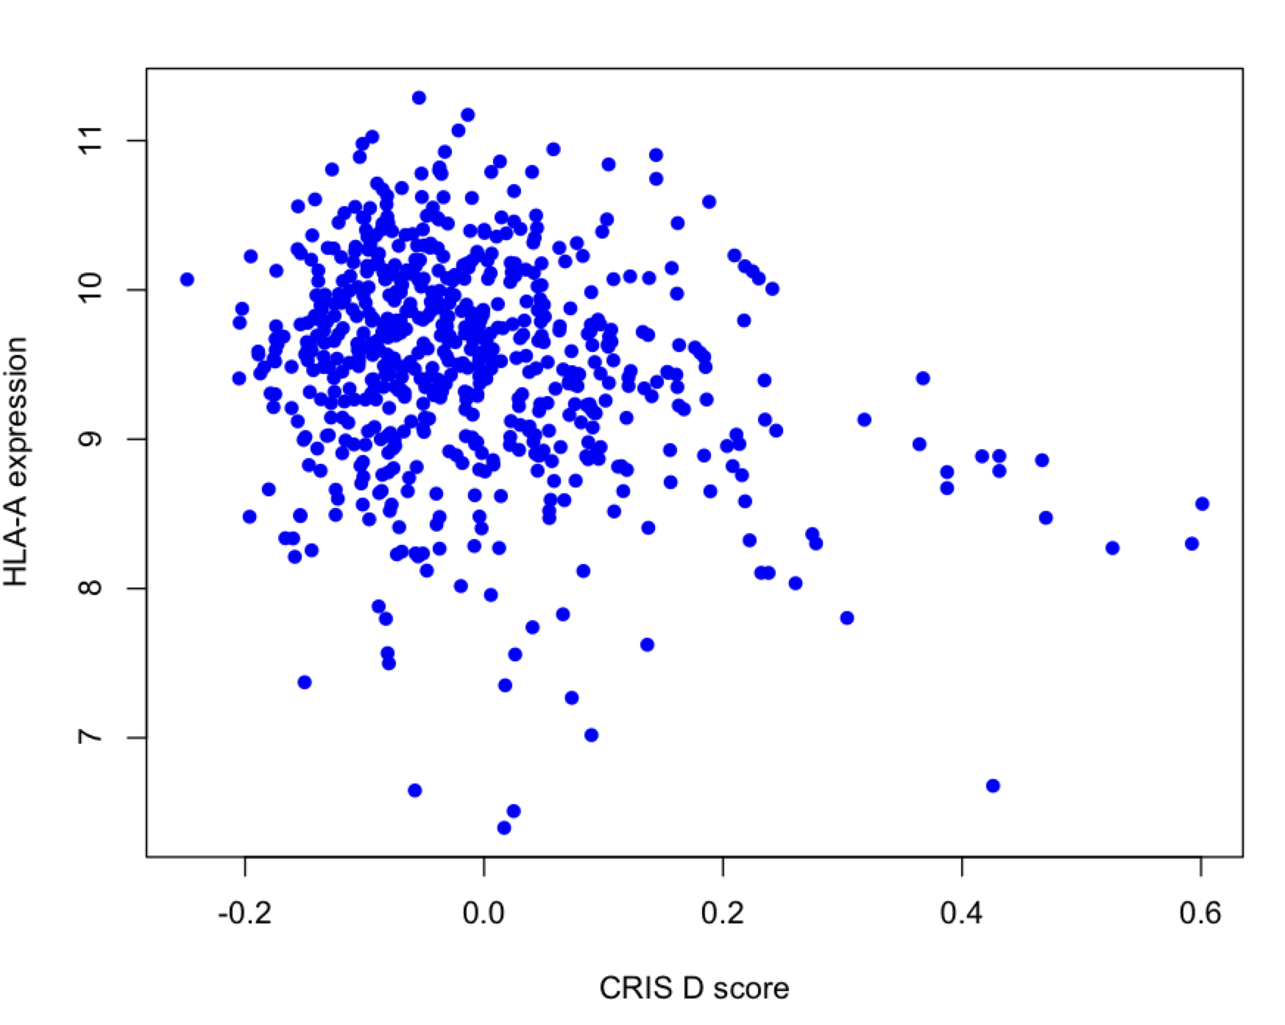
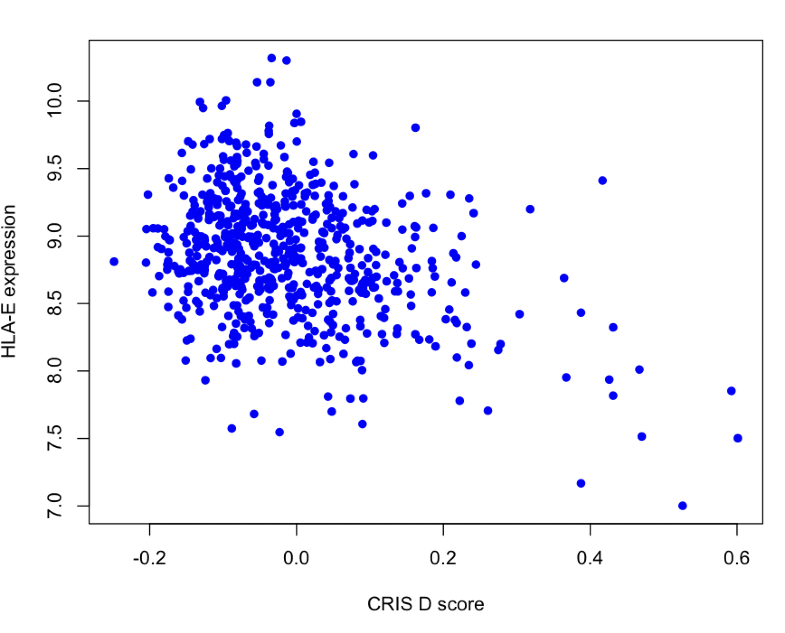
Our results in PDX

Slide 6
Next steps and goals
Validate our results in TCGA
Figure out which are the implications in terms of immune response and tumor progression
Understand which are the mechanisms behind this phenomenon

Slide 7
TCGA dataset
620 samples from COAD and READ fitered to 55415 genes
RNAseq data available in cpm, fpkm and tpm
For all samples, multicris annotations available
For 493 samples, annotations on growth rate available
For 456 samples, annotations on MS status available

Slide 8
TCGA and HLA genes
Correlation and polarization still shows but it’s minimal with respect to PDX and Cells

Slide 9
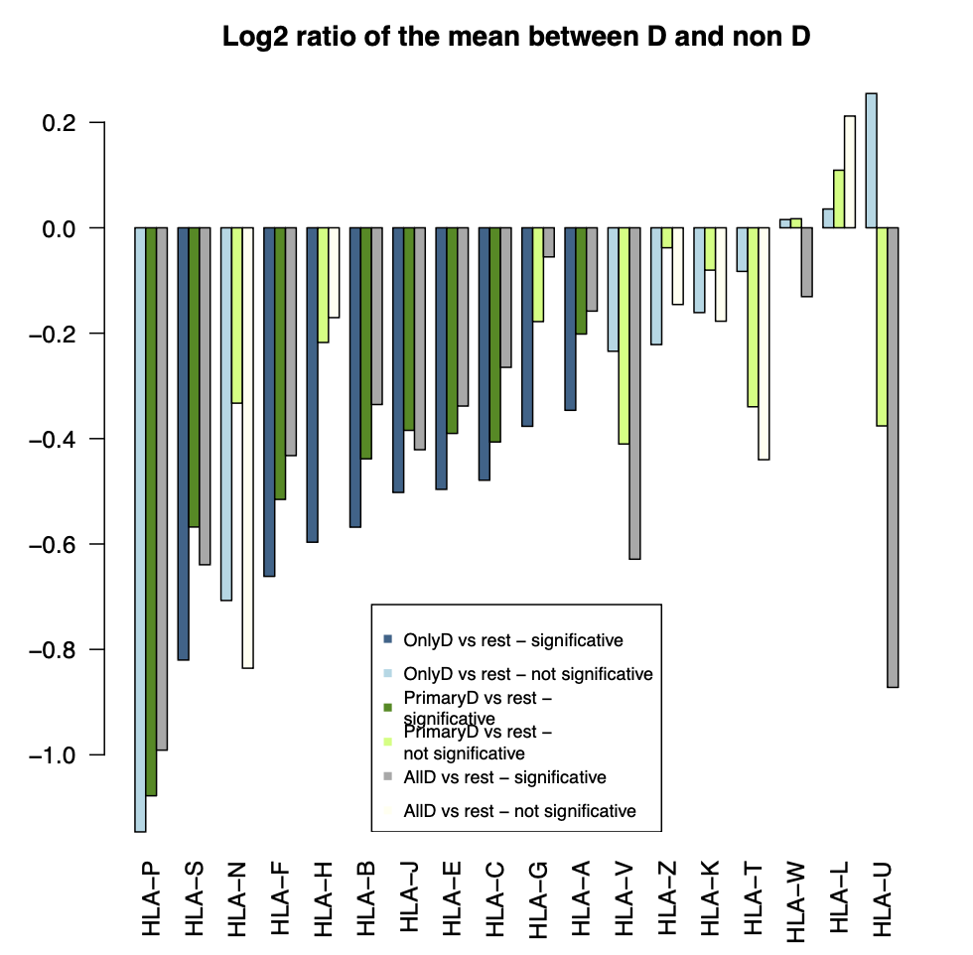
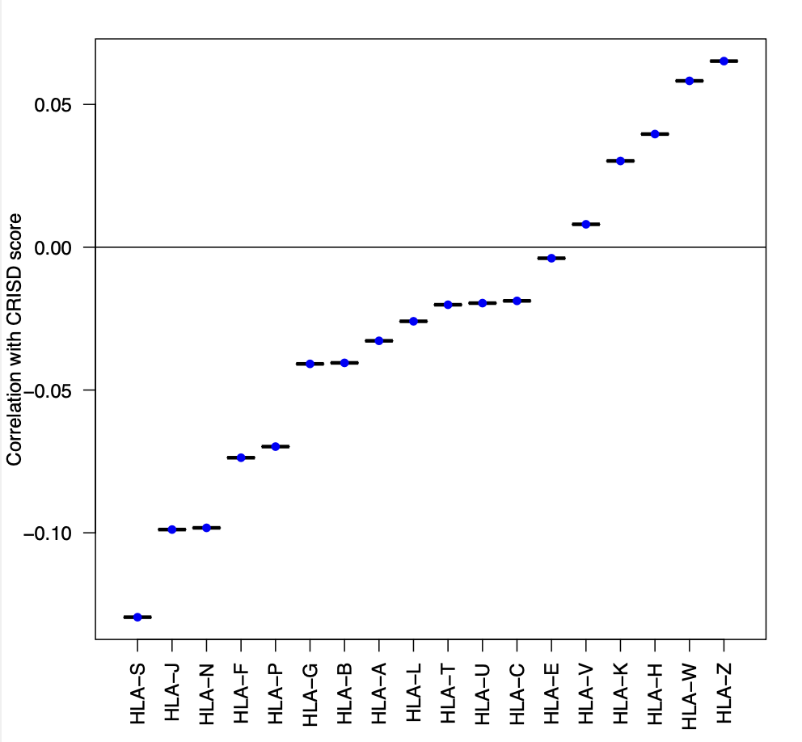
Considering multicris annotations is stronger than distance in TCGA, potentially due to lower purity of human tumor sample

Slide 10
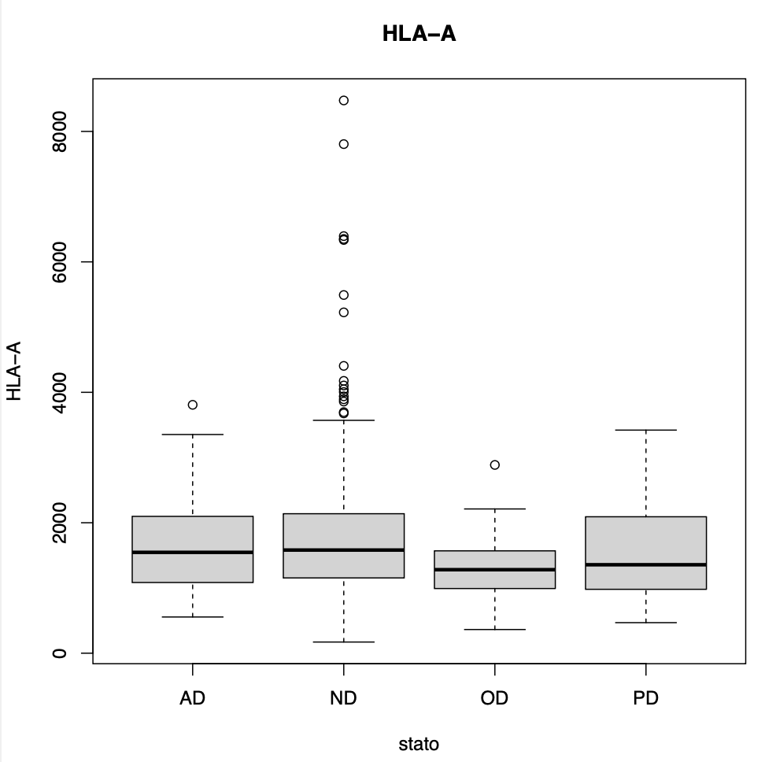
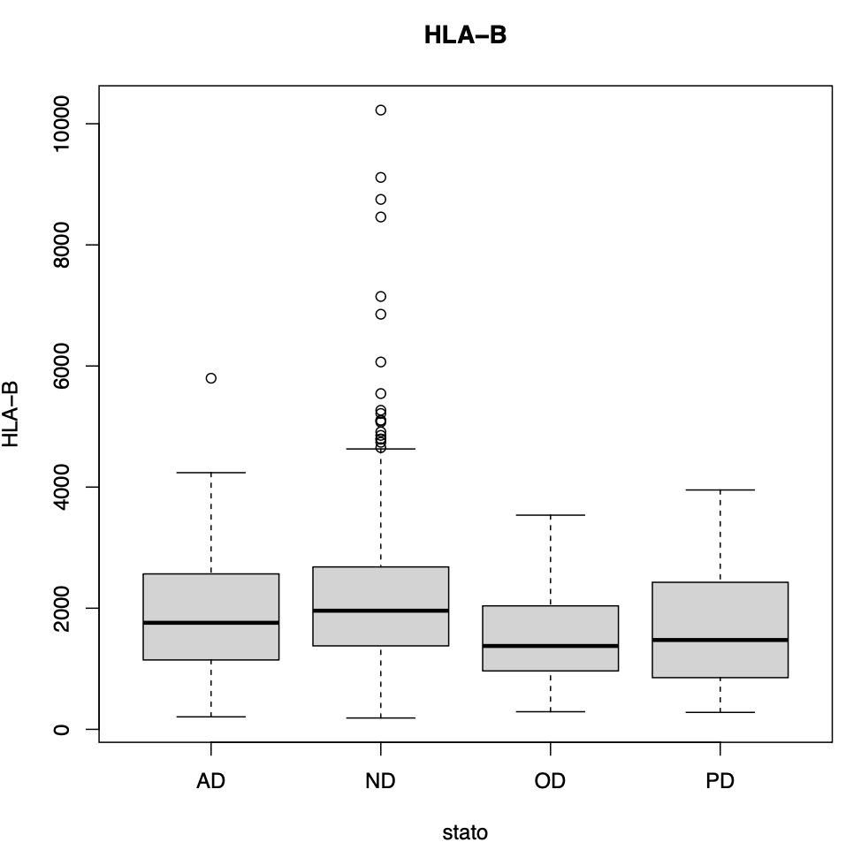
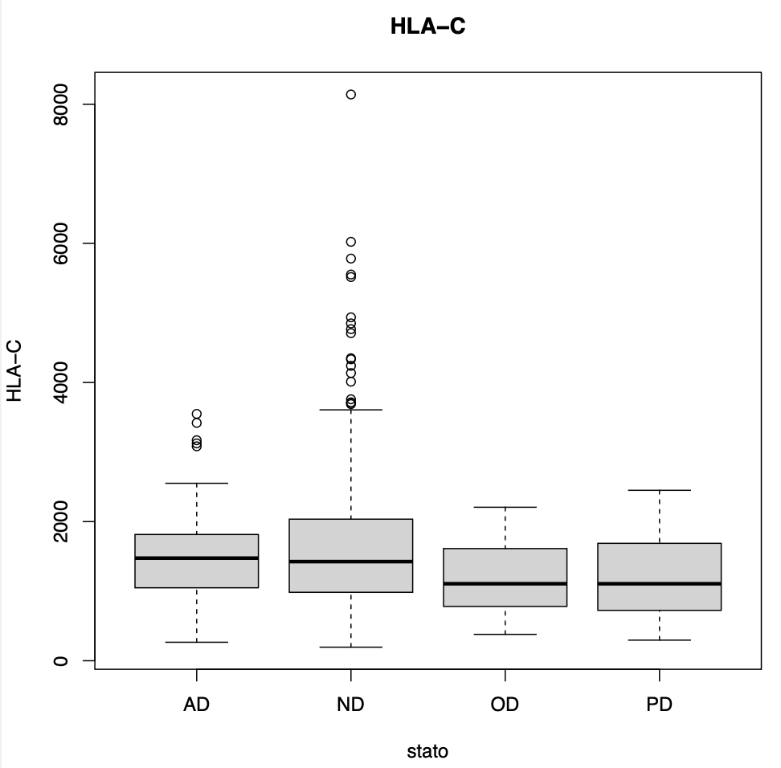
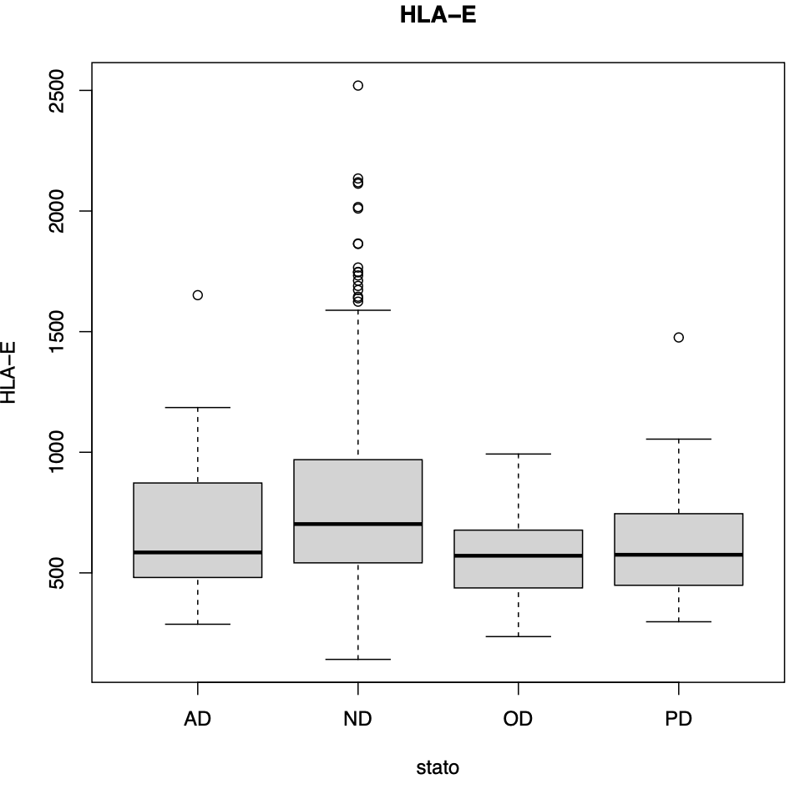
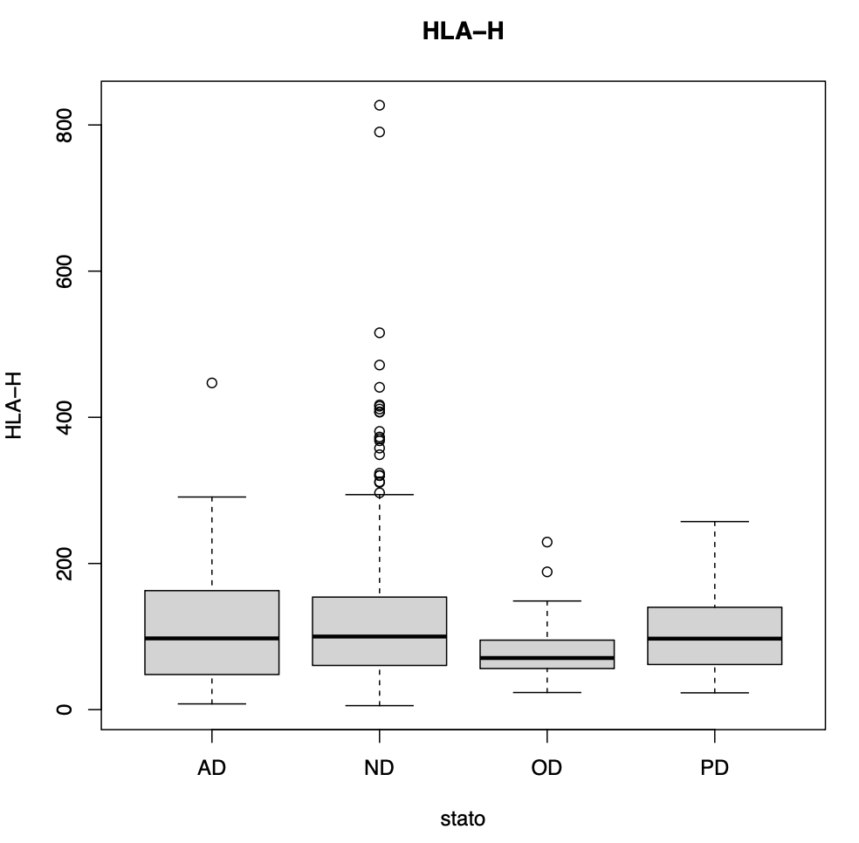
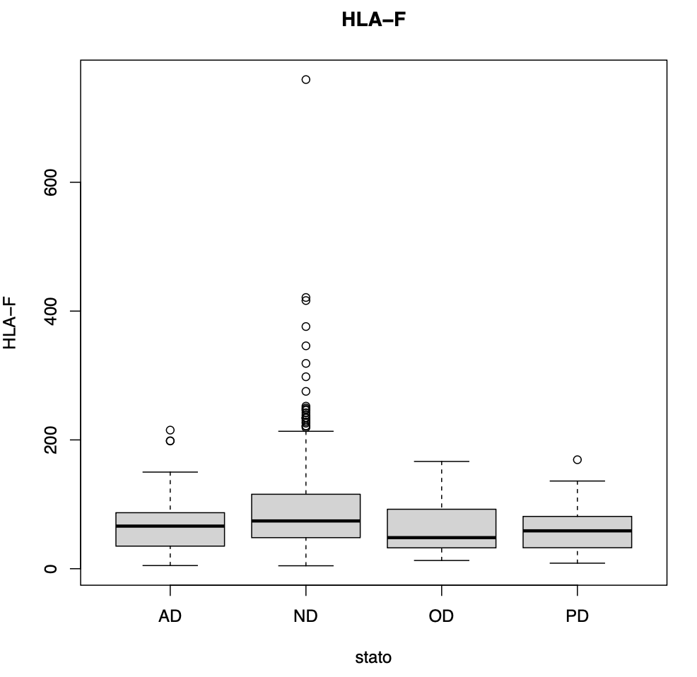
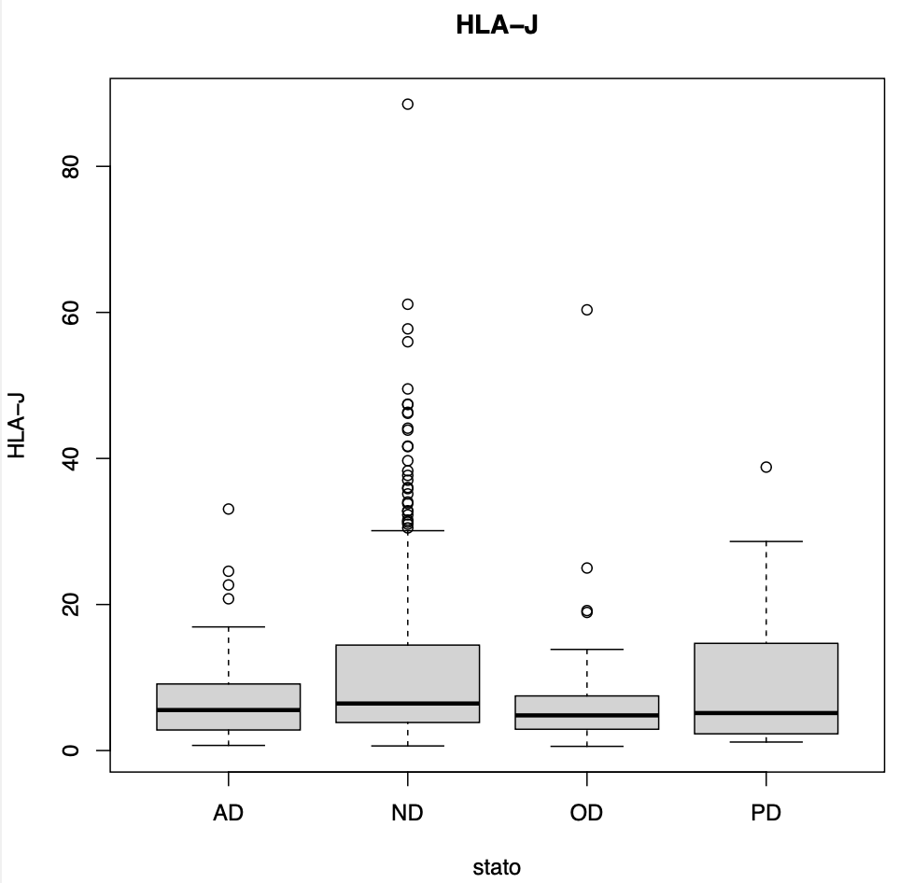
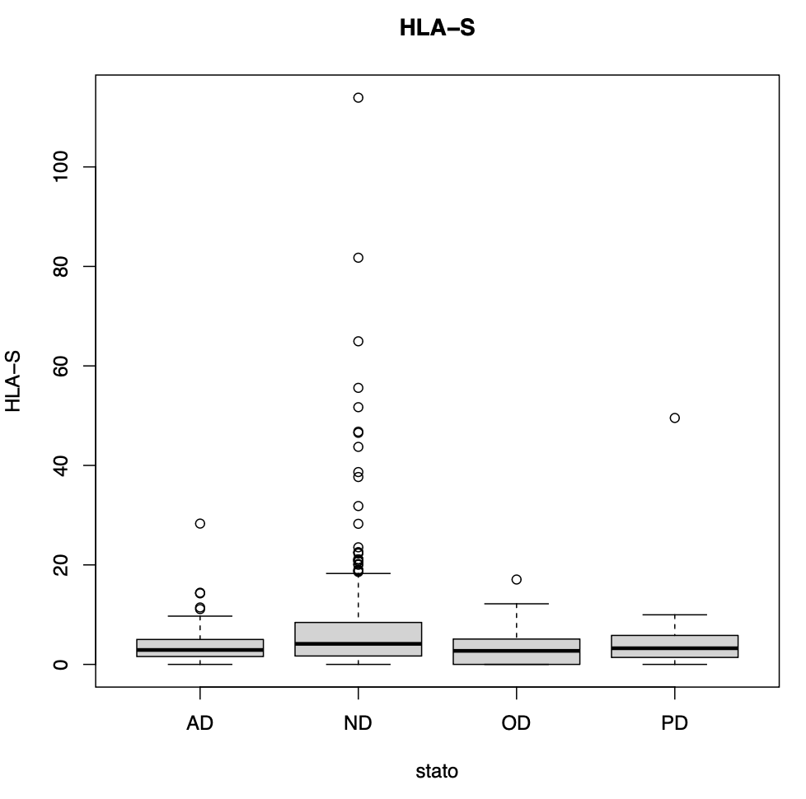
It seems that for most HLA class I, mean expression is lower in samples classified only as D.
Also, lower values do not seem to change significantly within classes, while higher values are consistently lower in CRISD samples, which is compatible with a negative selection from immune cells

Slide 11
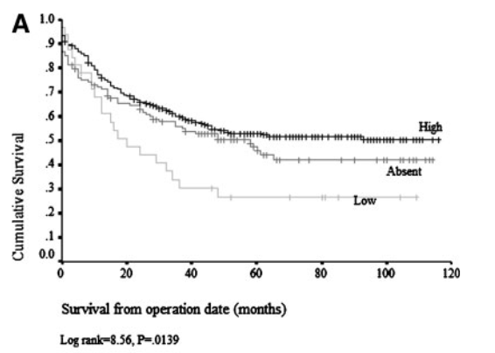
How does this HLA depletion impact the immune system?
In all kinds of CRC, MHC-I seems to have a lower expression in cancer cells with respect to normal tissue
While low levels of MHC-class I seem to correlate with a worse prognosis and overall outcome, total absence of MHC-class I is instead related to a better prognosis, similarly to MHC abundance in cancer cells. This could be due to the recruitment and activation of NK cells.
HLA antigen presentation is a consequence of the loss of HLA genes, but is can also be related to loss of b2microglobulin. The loss or mutation of the genes encoding β2m is a highly efficient mechanism for tumor escape

Slide 12
Contrarily to HLA genes RNA depletion, the effects of B2M downregulations are more clear. They appear to affect the levels of immune infiltration, rather than affecting activation of immune cells
This has been confirmed in our TCGA dataset by immune cell deconvolution algorithms. To do that, we first divided the patients in two clusters based on log2ratio. Then, we employed two different deconvolution algorithms.
What do we know about how this affects the immune system?

Slide 13
Xcell is a gene signature-based method.
After running the deconvolution algorithm, results for the 2 classes of B2M expressing patients we compared with t test, and an enrichment score was calculated by logarithm of the ratio between the mean score of each population for each group.
Notes:
Among the significative results, we find that most of the immune cells populations seem to be depleted in B2M low tumors, with the exception of CD4Tcm Th1 T helper cells and NKT.
During early tumor development, T helper (TH)1-like NKT cell subsets have the potential to rapidly stimulate tumor-specific T cells and effector NK cells that can eliminate tumor cells.
NKT and Th switch to Th2 in case of overstimulation. Thus, having higher NKT and Th1 could be representative of a state of lack of immune stimulation.

Slide 14
To validate and compare results with different deconvolution algorithms, we tried using FARDEEP, a linear deconvolution model.
To reduce noise in the tumor gene expression datasets, FARDEEP utilizes an adaptive least trimmed square to automatically detect and remove outliers before estimating the cell compositions.
While with FARDEEP we obtain less significative results, The method is concordant on the depletion of the immune cells.
Notes:
With fardeep, a distinction is made on the basis of the activation state. While active cells have a lower effect size, also their resting counterpart seems to be depleted. This is concordant more with an exclusion of cells from the immune environment rather than just the lack of activation. This is also consistent with the findings of Zhou et al

Slide 15
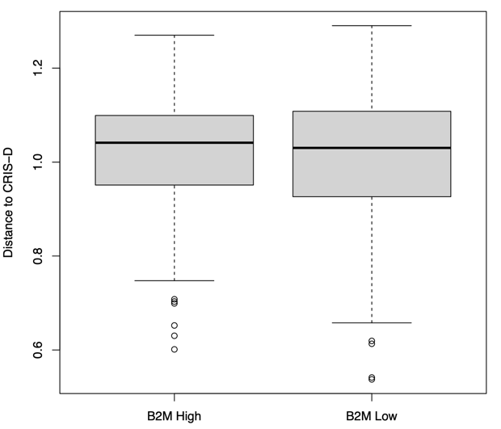
Could this be happening by depletion of high levels of HLA genes ?
While a lower B2M expression is more common in MSS tumors, CRIS C, D and E, its expression does not display significative variation in CRIS D with respect to other classes

Slide 16
Hence, what is the relationship between CRIS D and the immune system ?
All CRIS D
Xcell
Only CRIS D

Slide 17

All CRIS D
FARDEEP
Only CRIS D

Slide 18
Alternative approach
Rather than looking at infiltration of immune cells, we start looking for signs of immune activation states
Why?
Literature already proposes that what we see in some classifiers might be a temporal evolution of a cellular state.
What if this HLA depletion was a consequence of selection of less immunogenic cells?
What if the cell, as to escape immune selection was putting in place strategies to actively regulate an immune system which might as well be already there

Slide 19
How?
Performing GSEA based on gene ranking
The gene sets used correspond to all Gene Onthology terms which included the keywords “immune” and “regulation”
Of these, only those gene sets for which annotations were available on Ensembl database could be mapped.
A total of 109 Gene sets could be mapped.
Only the genes which were explored in the dataset werare considered for each gene set

Slide 20

To do: gsea in TCGA, PDX and Xenocells. After classification of the latter in multicris, also explore how the relationship changes with HLA genes

Slide 21
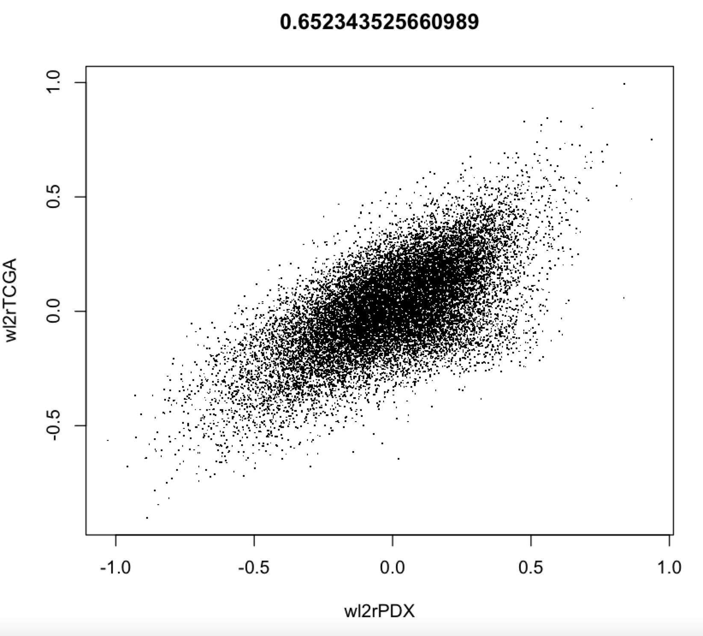
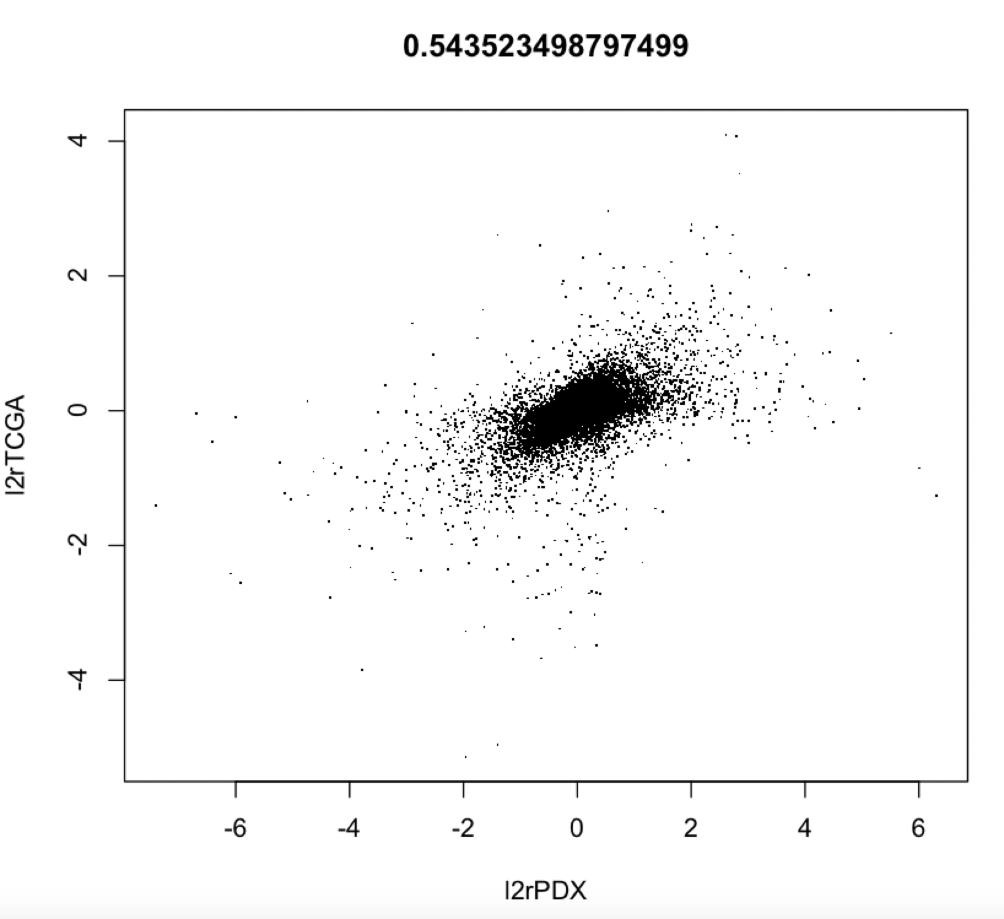
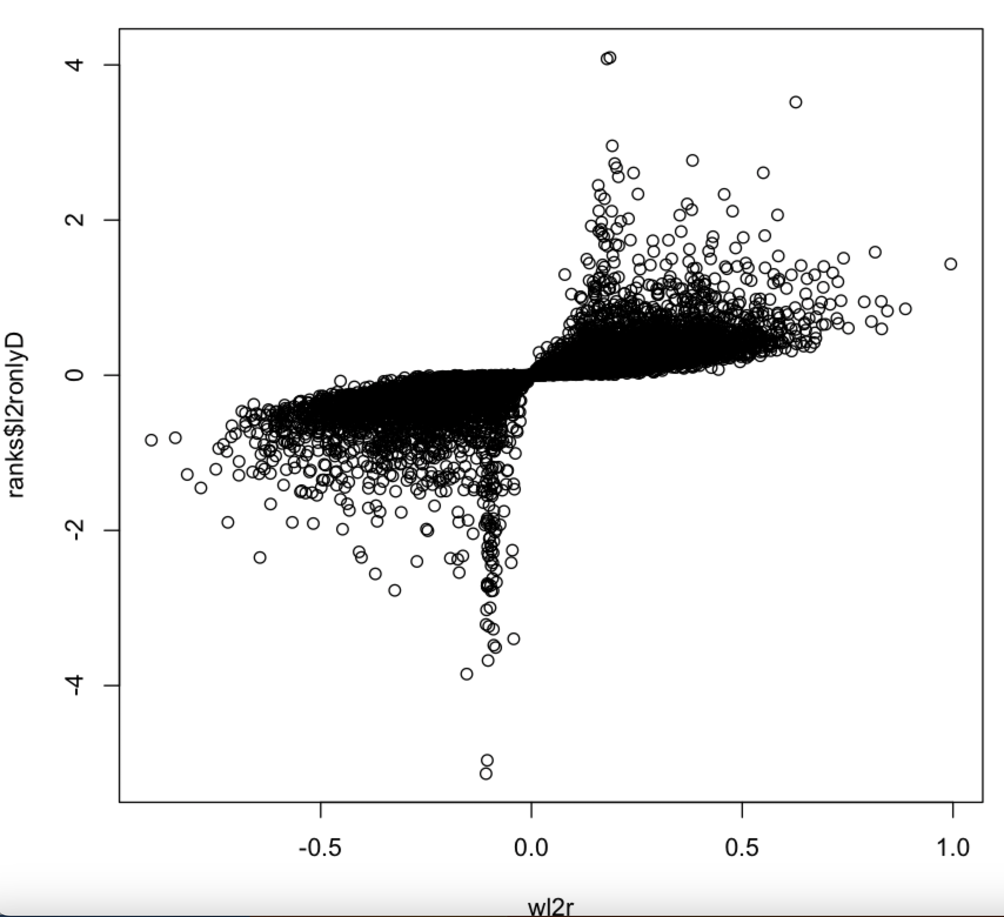
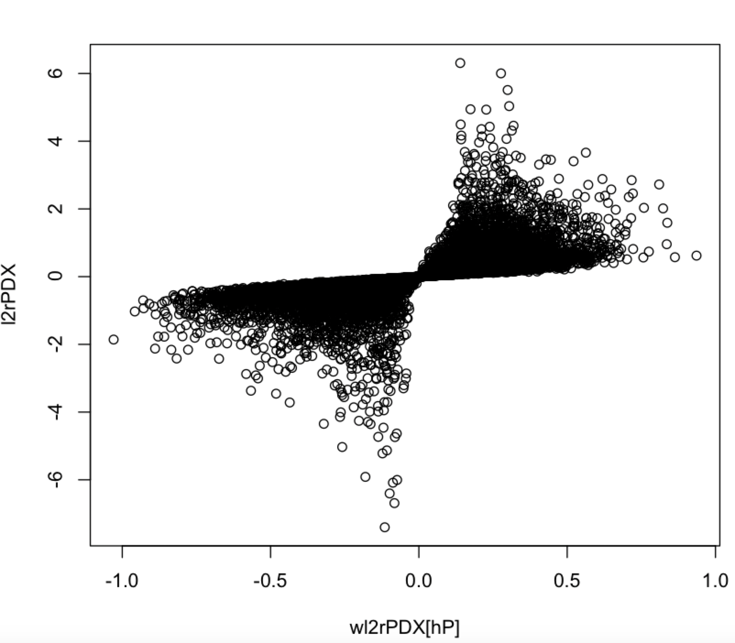
How to calculate the rank?
To be able to compare datasets of different nature, only genes shared betweeen the datasets were explored
Two different methods were explored:
A- log2 ratio between mean of genes in CRISD and NON-D samples
B- signal to noise ratio, considering difference of means but normalizing for variance within classes
Signal to noise ratio shows a best correlation between PDX and TCGA.
With respect to log2 ratio, the snr favours low l2r when variability within classes is low and downsizes high l2r when a high variability is encountered
* Cells were excluded due to their smaller dataset size and poor overlapping with the two other Datasets

Slide 22
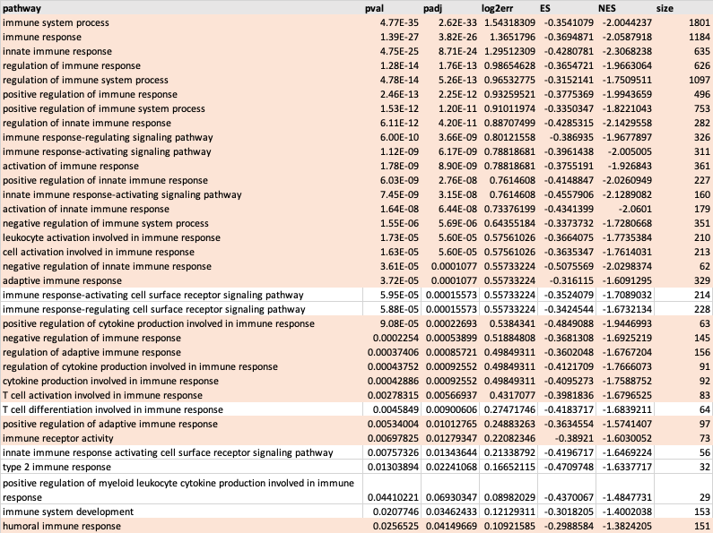
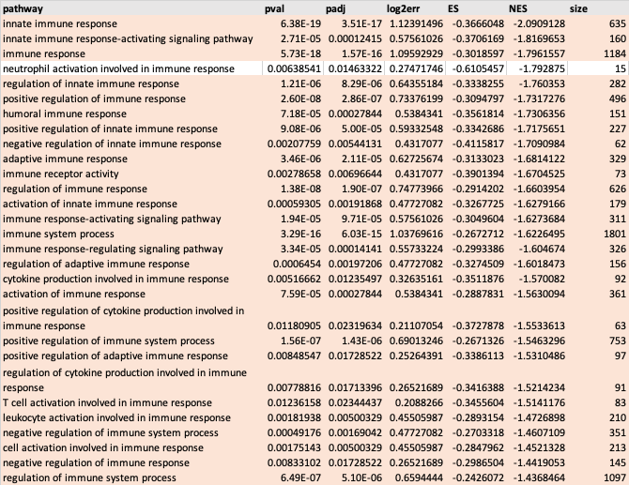
Immune regulation pathways
PDX
TCGA

Slide 23
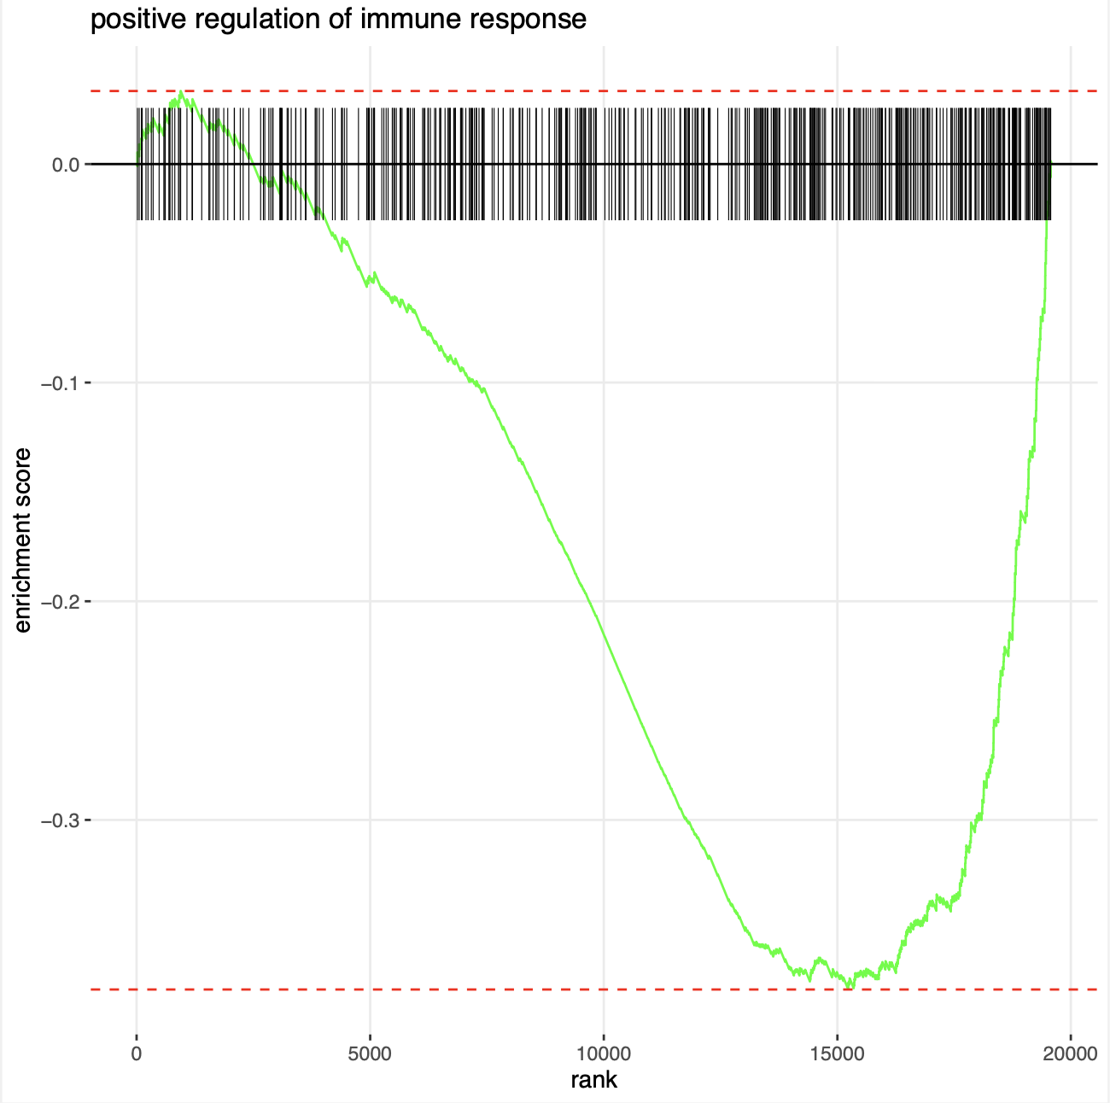
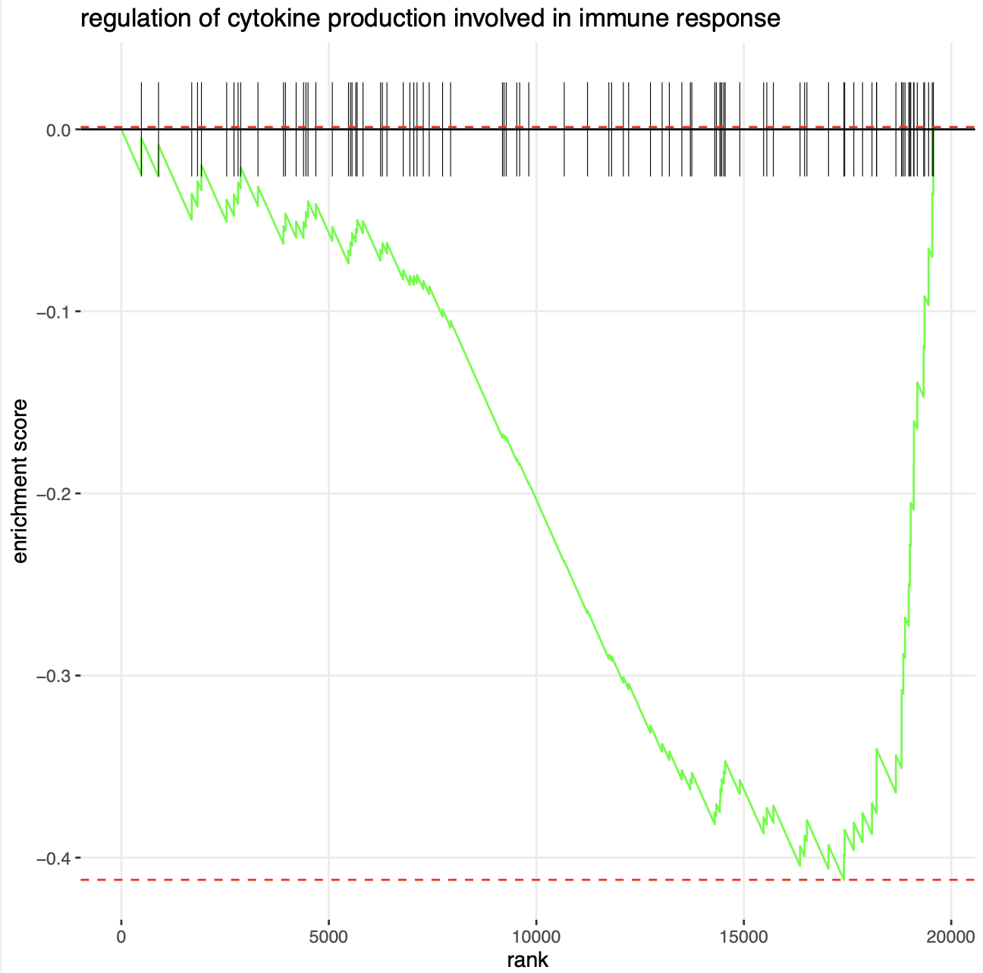
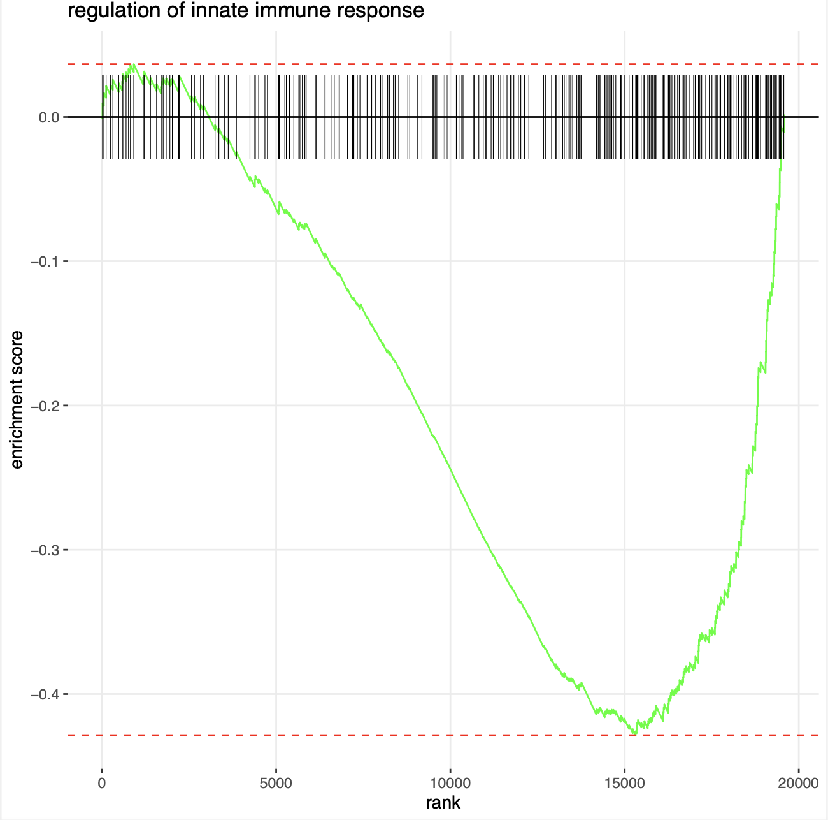
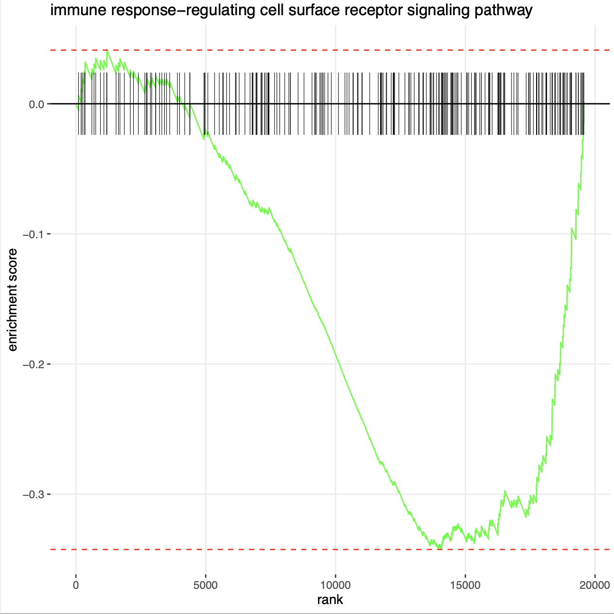
PDX

Slide 24
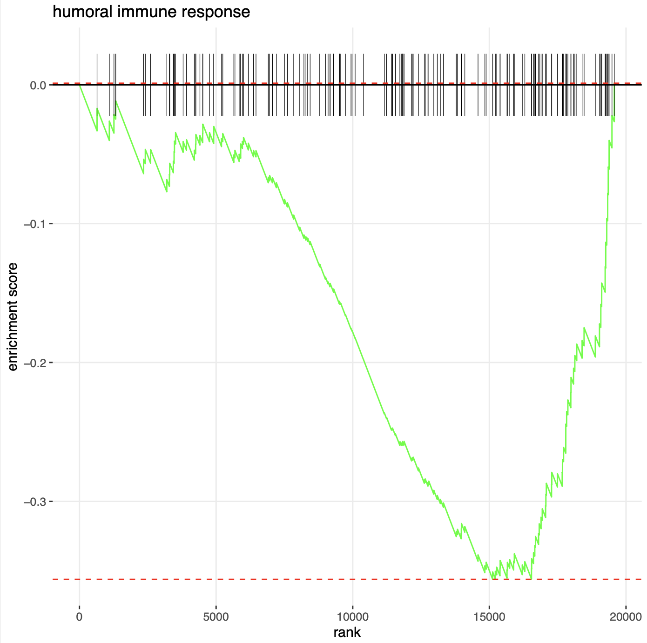
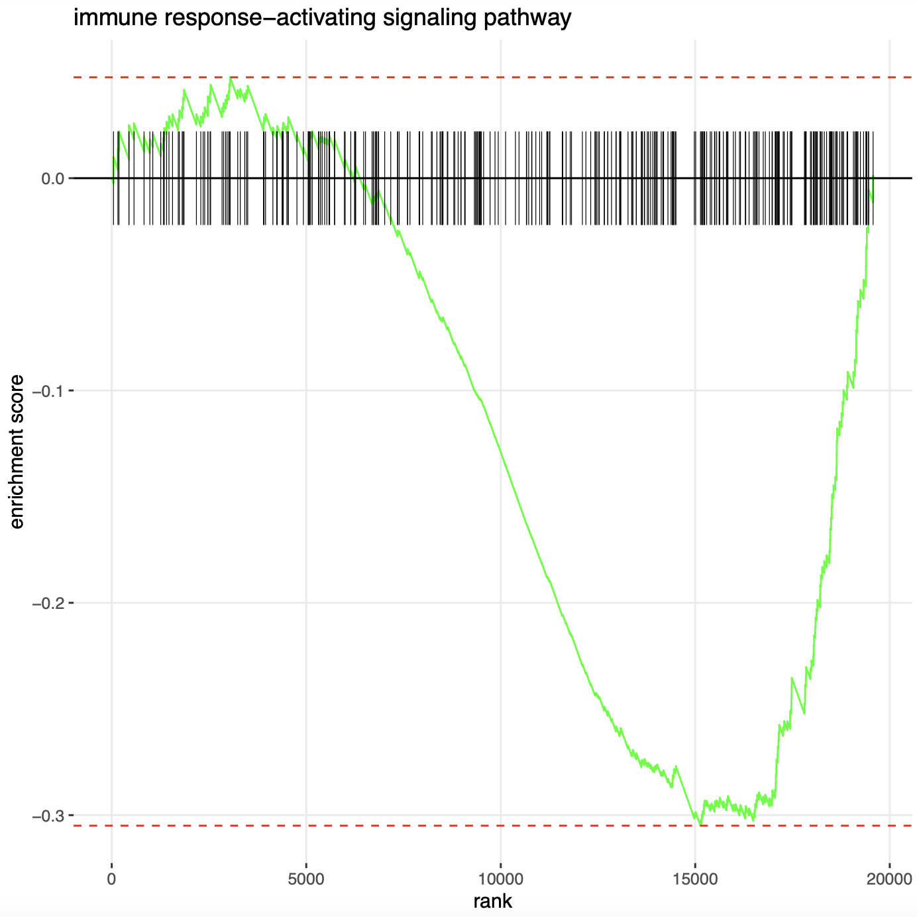
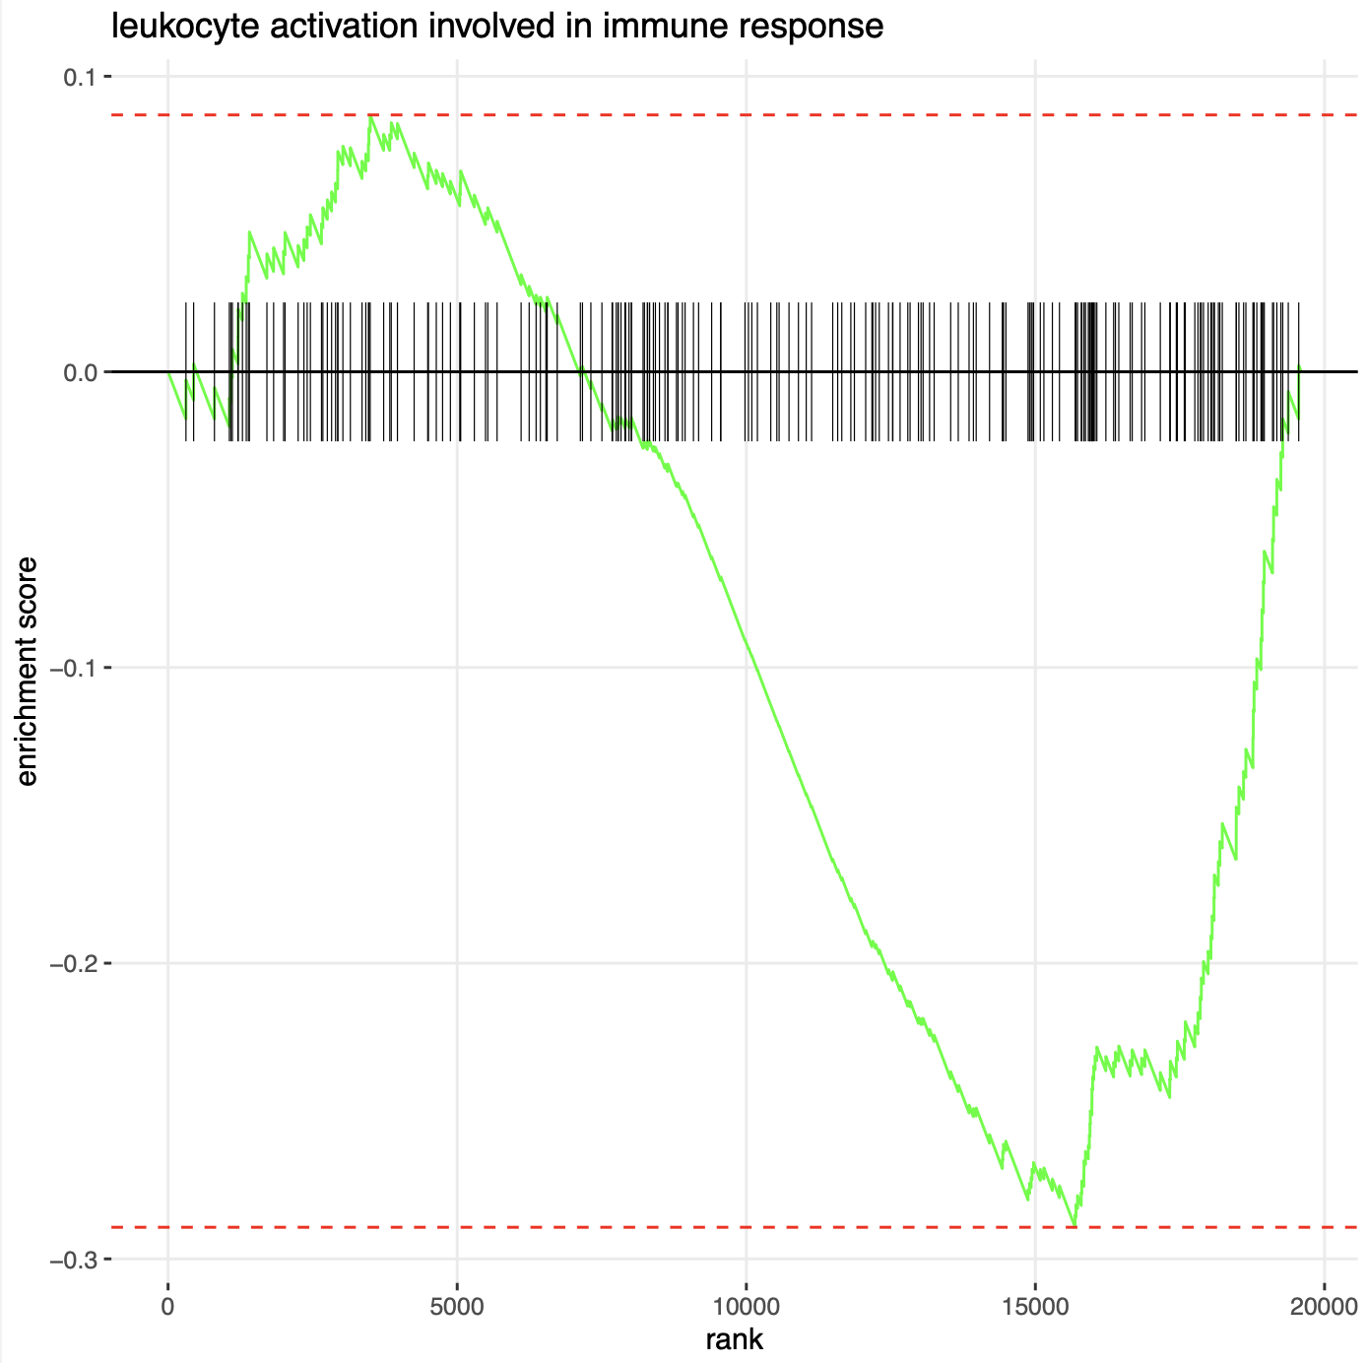
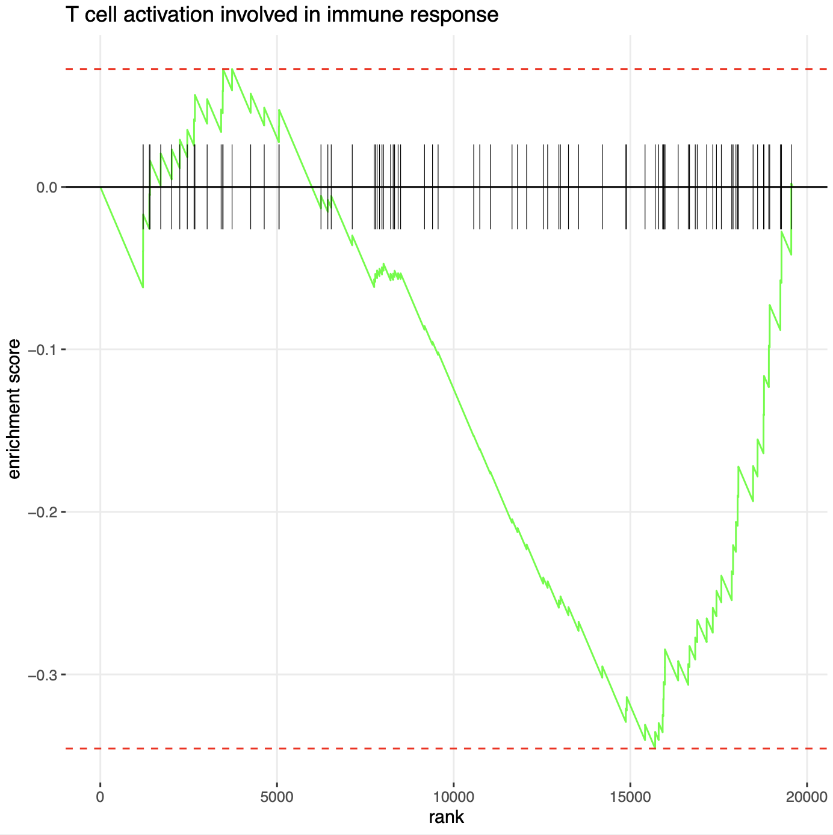
TCGA

Slide 25
What could explain the lack of immune cell exclusion in spite of the negative erichment of most immune activation pathway in CRIS D ?

Slide 26
A possible explanation: CRIS-D as a temporal evolution of higly immunogenic tumors
Investigating the nature of MSS- HLA negative tumors, which appear to be characterized by angiogenesis, extracellular matrix remodelling and TH2 responses,P Anderson et.al suggest how the stromal rearrangement associated with the tumour capsule could be a consequence of the end of the T cell- killing of HLA-I positive tumour cells and the beginning of a new phase characterized by a TH2-type response. Thus, different subtypes could represent different stages of the MSS CRC tumour progression

Slide 27
What could be the source of such immunogenicity?
In our case, it could potentially be the evolution of a highly immunogenic tumor, in which selection from immune cells lead to the loss of cells with high HLA expression and switch trough negative immune regulatory pathways

Slide 28
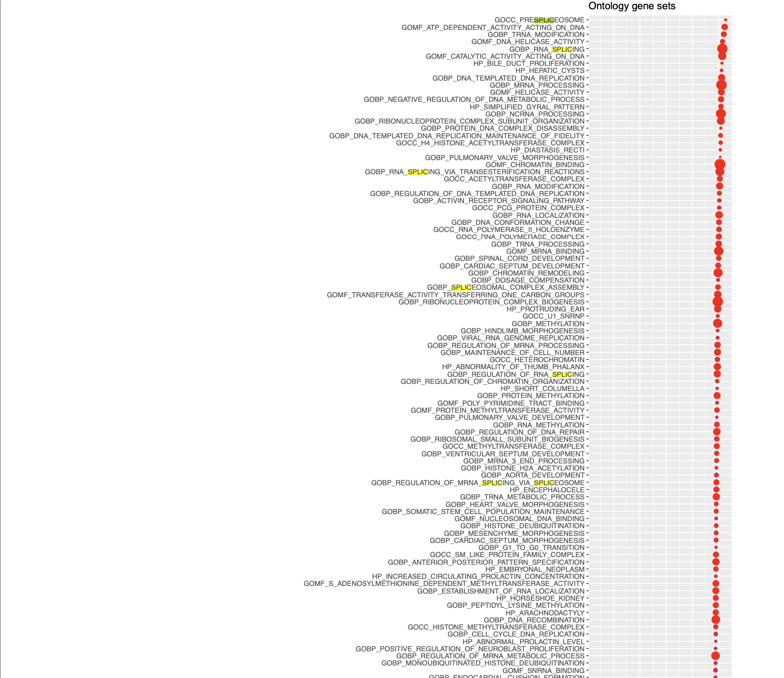
To look for signs of activated pathways, GSEA was performed using signal to noise ratio of log2ratio between expression in onlyD vs rest with all gene sets of the Gene Ontology database
Our proposal: transcriptional instability and alternative splicing variants

Slide 29

TIN
This study provides evidence for a high degree of variation among CRC samples with regards to amounts of differential exon usage. Based on this, we suggest TIN as a characteristic of CRC, which can be further dissected into the oTIN and sTIN subclasses.

Slide 30
Again, Gene Onthology is used and investigated for terms corresponding to splicing regulators. Here however, of the 49 terms, only 23 can be mapped.
For mapped terms, only mapped genes are used to build the gene sets.
Then, gsea is performed on TCGA first, using as rank the signal to nise ratio. A minimum size of 15 and maximun size of 500 is used to filter the gene sets.
Afterward, significative leading edges were used as gene sets in PDX, as to test wether the aspects reflected were cell intrinsic or merely environment dependent

Slide 31
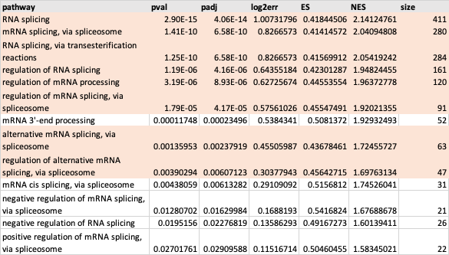
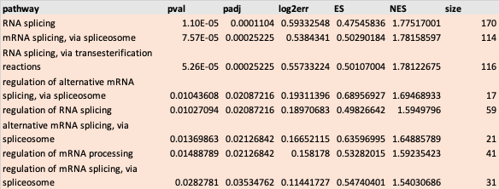
RNA processing pathways
PDX
TCGA

Slide 32
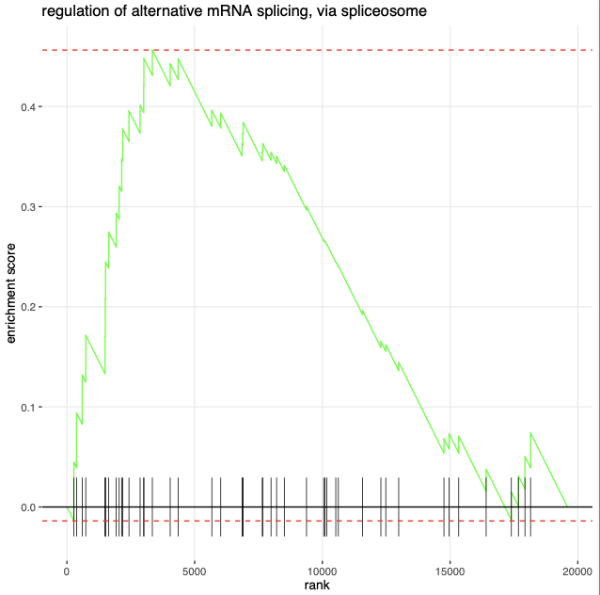
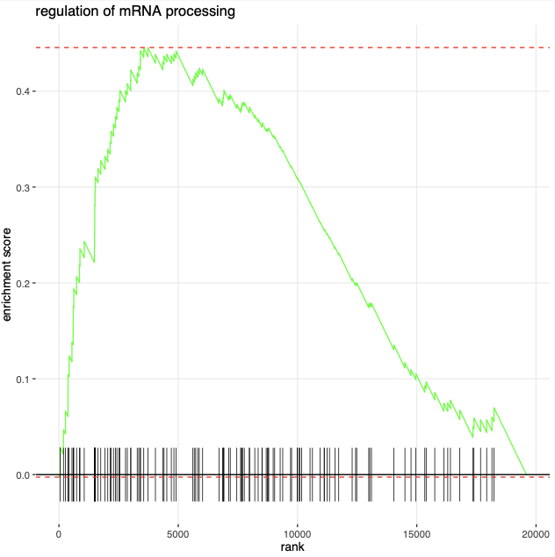
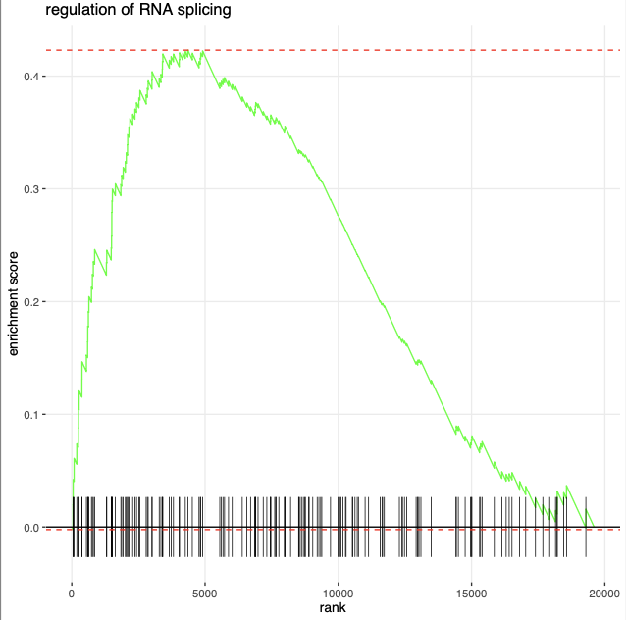
TCGA

Slide 33
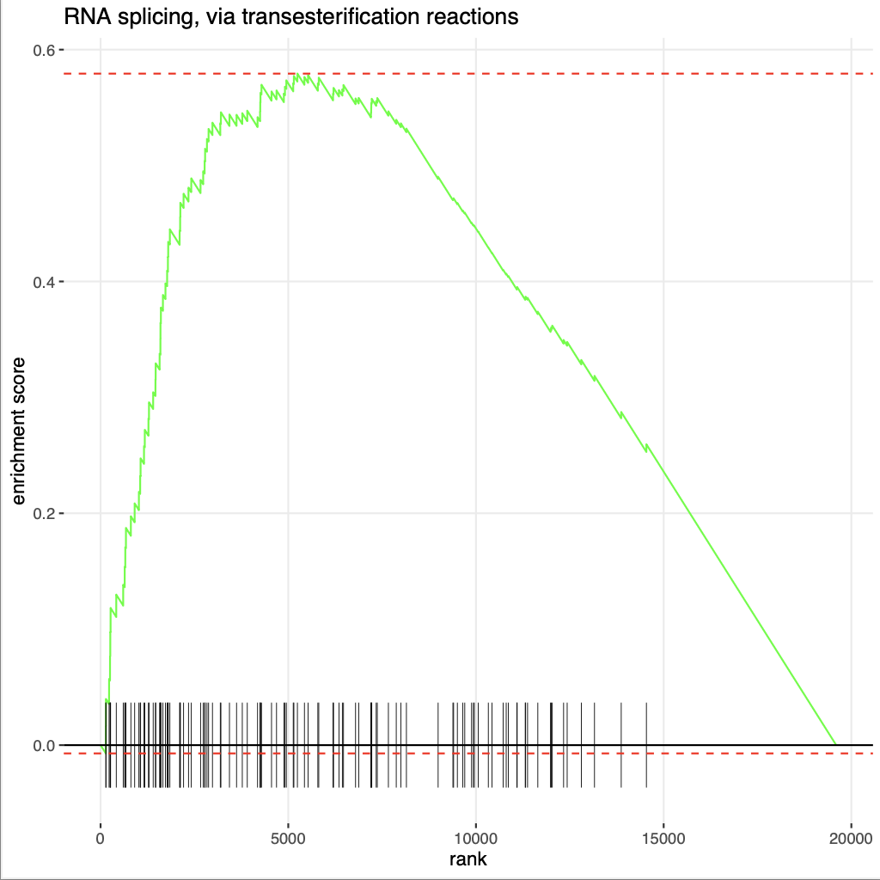
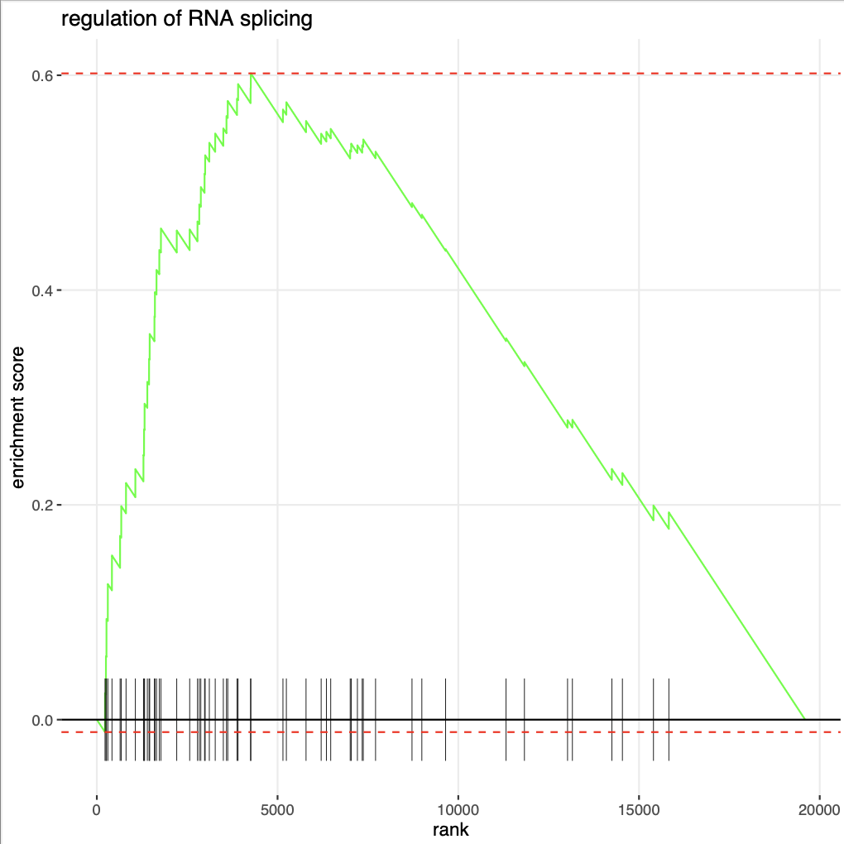
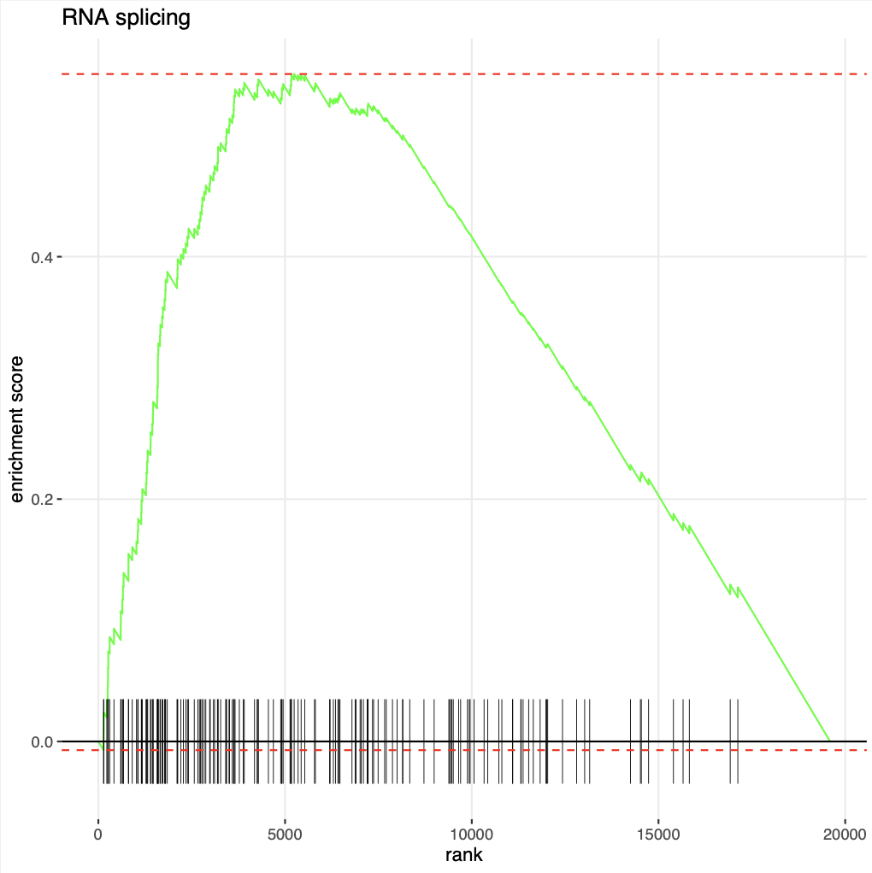
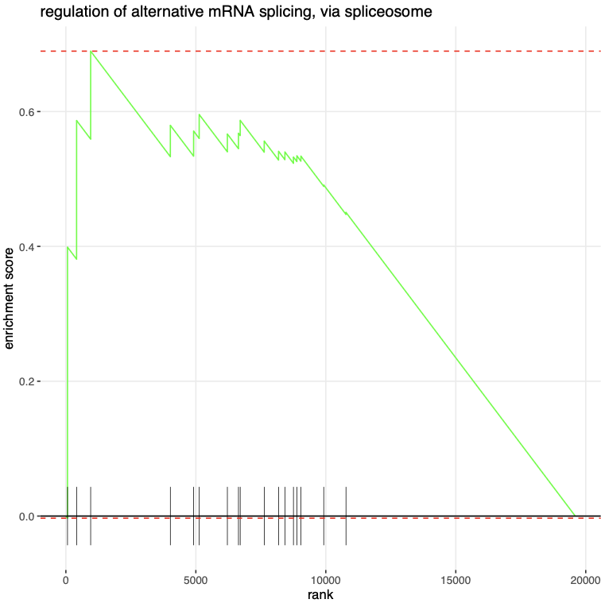
PDX

Slide 34

How to detect splicing events
With STAR alignment algoritm, detection of splicing junction can be performed by investigation of the so called “split reads”
The best way to detect them while being completely unbiased is to run star in the so called two pass mode
This means:
1) Running star without using any prior annotation about splice junctions
2) Re-run the alignment step using as annotations the splicing junctions retrieved in the first run
After this process, junctions classified as “un annotated” are more likely to be due to sequencing errors as they would not appear in both run

Slide 35
There are options used to filter split reads:
--outFilterType BySJout reduces the number of ”spurious” junctions
--alignSJoverhangMin 8 minimum overhang for unannotated junctions
--alignSJDBoverhangMin 1 minimum overhang for annotated junctions
--outSJfilterCountTotalMin default: 3 1 1 1
4 integers: minimum total (multi-mapping+unique) read count per junction for: (1) non-canonical motifs, (2) GT/AG and CT/AC motif, (3) GC/AG and CT/GC motif, (4) AT/AC and GT/AT motif. -1 means no output for that motif
Junctions are output if one of outSJfilterCountUniqueMin OR outSJfilterCountTotalMin conditions are satisfied
does not apply to annotated junctions
--outSJfilterDistToOtherSJmin default: 10 0 5 10 4 integers>=0: minimum allowed distance to other junctions’ donor/acceptor does not apply to annotated junctions
--outSJfilterIntronMaxVsReadN default: 50000 100000 200000 N integers>=0: maximum gap allowed for junctions supported by 1,2,3,,,N
reads
i.e. by default junctions supported by 1 read can have gaps <=50000b, by 2 reads: <=100000b, by 3 reads: <=200000. by >=4 reads any gap <=alignIntronMax
does not apply to annotated junctions
--outSJfilterReads default: All string: which reads to consider for collapsed splice junctions output All: all reads, unique- and multi-mappers Unique: uniquely mapping reads only
--outSJfilterOverhangMin default: 30 12 12 12
4 integers: minimum overhang length for splice junctions on both sides for: (1) non-canonical motifs, (2) GT/AG and CT/AC motif, (3) GC/AG and CT/GC motif, (4) AT/AC and GT/AT motif. -1 means no output for that motif
does not apply to annotated junctions
--outSJfilterCountUniqueMin default: 3 1 1 1
4 integers: minimum uniquely mapping read count per junction for: (1) non-canonical motifs, (2) GT/AG and CT/AC motif, (3) GC/AG and CT/GC motif, (4) AT/AC and GT/AT motif. -1 means no output for that motif
Junctions are output if one of outSJfilterCountUniqueMin OR outSJfilterCountTotalMin conditions are satisfied
does not apply to annotated junctions
Information on splicing junction are stored in the SJ.out.tab output file

Slide 36

SJ.out.tab
SJ.out.tab contains high confidence collapsed splice junctions in tab-delimited format. Note that STAR defines the junction start/end as intronic bases, while many other software define them as exonic bases.
STAR generates one of such files for each sample
What is in the file?
column 1: chromosome
column 2: first base of the intron (1-based)
column 3: last base of the intron (1-based)
column 4: strand (0: undefined, 1: +, 2: -)
column 5: intron motif: 0: non-canonical; 1: GT/AG, 2: CT/AC, 3: GC/AG, 4: CT/GC, 5: AT/AC,6: GT/AT
column 6: 0: unannotated, 1: annotated (only if splice junctions database is used)
column 7: number of uniquely mapping reads crossing the junction column 8: number of multi-mapping reads crossing the junction column 9: maximum spliced alignment overhang

Slide 37

How the file looks like
To asses the relationship between CRISD class and splicing, we analyzed SJ.out.tab file for in vivo cell lines transplanted into PDX
From the analysis we excluded:
PDX derived cell lines
Cell lines with low tumor purity (more than 0.6% of murine content in the samples)
Cell lines for which no SJ.out.tab file could be retrieved

Slide 38
STAR alignment of RNA sequencing data for in vivo cell lines
Exclusion of
PDX cell lines
Samples with low purity
Samples with no SJ.out.tab
Collect SJ.out.tab file for 136 samples
Study design
Aggregation of all splice junctions for all samples
ntp algorithm used to predict CRIS class and integrate annotations
Normalization on the number of assigned usable reads • 10⁶
Assesment of relationship for each annotation and CRISD status
Annotation of each junction based on
Transcript alignment
Transcript biotype
Gene annotation
Length
Splicing motif
Previous annotation
For each splice junction, retrieval of number of uniquely mapped reads for each sample

Slide 39




If instead of read count we consider only the different SJ with more reads than the threshold…

Slide 40




Using higher trasholds, the difference is lost
This is compatible with the fact that a high number of reads could imply that reads accumulate in a lower number of splicing junctions, which is representative of a landscape of canonical splicing

Slide 41

The biggest difference among the two groups is in the number of classical GT/AG and CT/AC motifs
Some difference can also be seen for groups 4, 5 and 6
However, the most abundant sites remain classical ones

Slide 42




Annotational status
Pay attention to what STAR considers as “annotation”
For annotated junctions there seems to be a consistent difference among groups, while considering unannotated ones, as the cutoff gets more stringent, the number is so low that this difference is lost

Slide 43


These are ensembl ANNOTATED intron retentions

Slide 44
DRAWBACKS
Experimental procedure, never tested before
It does not allow to quantify and call intron retention
Useful informations only for annotated transcripts

Slide 45

How to detect and quantify de-novo intron retention events?
IRFinder https://genomebiology.biomedcentral.com/articles/10.1186/s13059-021-02515-8#article-info

Slide 46

CNN network is used as a filter and selects allIR with a minimum of 0.05%IR Ratio. It then assigns a IR score

Slide 47

Drawbacks
Poor reproducibility
At high cutoffs you eliminate candidates without improving quality of introns

